Slide 1
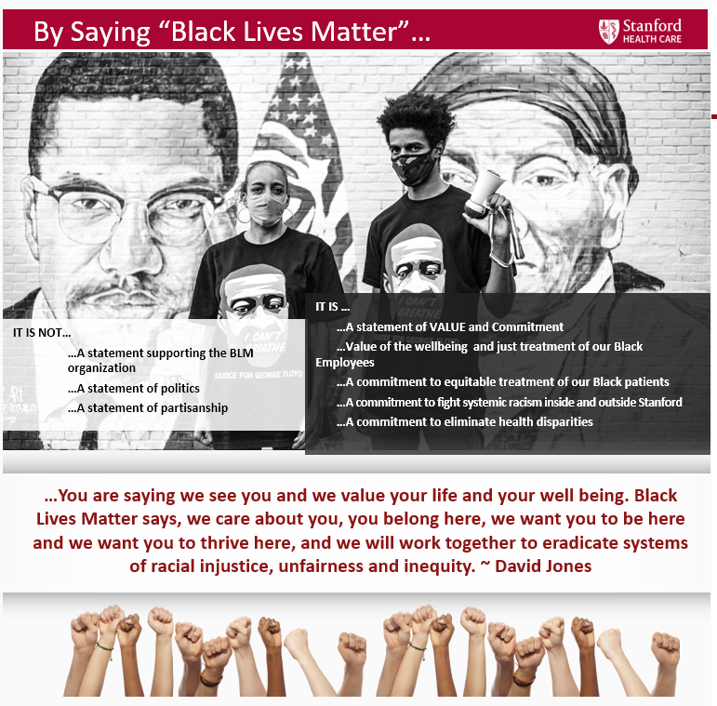
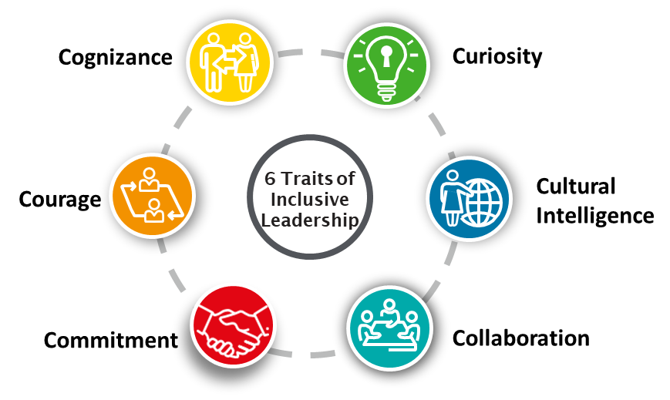
Overview of the Huddle Sheet
Inclusion, Diversity and Health Equity | October
Vis-wall Poster, page 2
Black Lives Matter (BLM) Conversations
Why saying Black Lives Matter is important
Why is saying Black Lives Matter so important?
Saying Black Lives Matter is an act of acknowledging the historic and systemic racial inequities and injustices against the Black community.
Black people are disproportionately killed by the police because of their race and receive longer prison sentences for committing the same crimes as White people.
In a study done by the National Institutes of Health Office of Research on Women’s Health Black babies are twice as likely as White babies to die before their first birthday.
According to the Center for Disease Control:
Black women are 243% more likely to die in childbirth than White women, due to lack of access to sufficient health care.
Black Americans are 2.6x higher to contract COVID-19 and 2.1x higher to die compared to white Americans.
These statistics collectively send the message that Black lives do not matter in our society, so, this movement is calling attention to these injustices.
Describes the Rational for the Conversation
WHY?
Lay the foundation to Why saying Black Lives Matter is important
Recommends Educational Resources
Huddle Preparation:
Learn: Read or watch two or three of the following resources:
Why You Need to Stop Saying "All Lives Matter
Why Saying “All Lives Matter" Communicates to Black People That Their Lives Don’t
Coronavirus Deaths Show How Little Black Lives Matter In American Healthcare
A White Mom Marched Alone to Say ‘Black Lives Matter.’ Her Black Son Urged Her to Do More
SHC IDHE Anti-Racism & Equity Resources click HERE
Reflect: Take a moment to self-reflect about your reaction to what you learned about BLM. Recognize and acknowledge the validity and reality of the Black community lived experiences.
Consider that by saying Black Lives Matter and posting page 2 on your Vis-wall you are demonstrating your commitment to:
The wellbeing and equitable treatment of our Black Employees, patients and community.
Fight systemic racism and eliminate health disparities .
Huddle Conversation:
The Huddle is our opportunity to show that we care, and demonstrate our support for our Black team members, patients, and community. Approach the conversation with empathy, curiosity and compassion.
Share: Leader shares why they’re having this conversation and what they’ve learned and how they are feeling. Your level of vulnerability sets the tone for the conversation. Select a few key concepts that resonated with you in your preparation. An example might sound like this, “At first, I was under the impression all lives matter. In reading the Harpers Bazaar article, I learned people who are Black are twice as likely to be killed by a police officer while unarmed, compared to a White individual. Therefore, by saying “Black Lives Matter” it isn’t about excluding others, rather it’s about a rallying cry to end injustice and system racism. These injustices are still happening, we are experiencing it again with the verdict of Breonna Taylor.”
Ask: How are you feeling? What are your thoughts?
Respond: Leader recognizes and acknowledges the thoughts and feelings being shared. It’s important to listen with curiosity, knowing you don’t need to have all the answers or change someone’s beliefs.
Thank: Leader thanks team members for sharing their insights and experiences. Remind them that acknowledging and discussing the inequities that exist demonstrates caring. These types of conversations helps us make cultural differences more visible and are a first step in our healing and leading meaningful change.
LEARN
Share what you learned
SHARE
REFLECT
Provides Concepts to Reflect on
Expand the Conversation
ASK
Encourage & Acknowledge
RESPOND
Encourages Perspectives to Consider
CONSIDER
Appreciate teams’ input
THANK
Notes:
October: Why Inclusion, Diversity and Belonging Matters
November: Why Health Equity Matters
We are demonstrating our commitment to our employees and patients
forces some to admit an uncomfortable truth. That all lives can’t matter until Black Lives Matter. Commit: Display on your Vis-wall
It is a statement of VALUE and Commitment
…Value of the wellbeing and just treatment of our Black Employees
…A commitment to equitable treatment of our Black patients
…A commitment to fight systemic racism inside and outside Stanford
…A commitment to eliminate health disparities
Respond: Leader acknowledges the thoughts and feelings being shared. It’s important to listen, knowing you don’t need to change someone’s beliefs or have all of the answers.
Thank: Leader thanks team members for sharing their insights and experiences. This conversation helps us make cultural differences more visible. Acknowledging that inequities exist demonstrates caring and is a first step in our healing and leading meaningful change.
Saying Black Lives Matter is an act of acknowledging the historic racial systemic inequities and injustices against the black community.
CDC reports Black Women are 50% more likely to die of Breast Cancer than white women
Black people are disproportionately killed by the police because of their race, make less than what White workers make doing the same job, receive longer prison sentences for committing the same crimes, etc. These statistics collectively send the message that Black lives do not matter in our society, so this movement is calling attention to these injustices. Other ways of thinking of it are Black Lives Matter Too or Black Lives Matter As Well.

