Slide 1
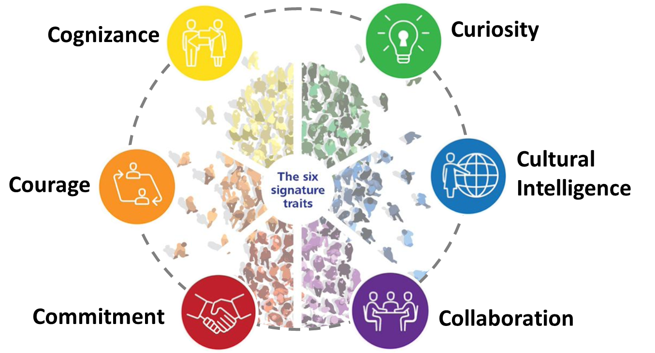
Elements of the Conversation Sheet
Inclusion, Diversity and Health Equity | MARCH
Utilize the Conversation Sheet to Engage with Staff
Hate Crimes Against Asian Americans Conversations
Why is discussing hate crimes against Asian Americans so important?
WHY?
Provides the rational for the conversation
Hate crimes against Asian Americans have increased at a much higher rate since the start of the pandemic. This type of racism isn't necessarily an individual harming another person, it's a systemic issue. The concerning increase in violence towards the Asian American and Pacific Islander (AAPI) community, following a year of xenophobic rhetoric and racist attacks amid the pandemic has taken a toll on the Asian American community that impacts our workforce. Here the statics to be aware of:
Stop AAPI Hate, a reporting database created at the beginning of the pandemic as a response to the increase in racial violence, received 2,808 reports of anti-Asian discrimination between March 19 and December 31, 2020. The violence has continued into 2021, and President Joe Biden signed an executive order denouncing anti-Asian discrimination shortly after taking office in January 2021.
While anti-Asian violence has taken place nationwide and particularly in major cities, the uptick in attacks in 2021 has been particularly focused in the Bay Area, especially in San Francisco and Oakland’s Chinatowns.
LEAD: LEARN – ENGAGE – ACKNOLWEDGE – DO
Why Acknowledging Hate Crimes Against Asian Americans is Important LEAD: LEARN – ENGAGE – ACKNOLWEDGE – DO
Recommends Educational Resources
PREPARING FOR THE CONVERSATION:
LEARN: Review two or three of the following resources:
Why Some Asian Americans Are Staying Silent About the Ongoing Hate Crimes; here's how allies can show support during this time.
Hate Crimes Against Asian Americans Are on the Rise. Many Say More Policing Isn't the Answer
Hate crimes talking points for COVID
Reflect: Take a moment to explore your reaction to what you learned about hate crimes against Asian Americans. Recognize and acknowledge the validity and reality of Asian American and the need to address the environment that gave rise to the violence.
Consider: By discussing hate crimes against Asians you are demonstrating your commitment to:
The wellbeing and equitable treatment of our Asian American employees, patients and community.
Ensuring a safe, compassionate, and empathetic work environment for all employees.
Provide SHC Resources: The Anti-Retaliation and Non-Discrimination SHC policies are available on-line for you to reference and share.
CONDUCTING THE CONVERSATION:
This conversation is an opportunity to show our Asian American team members, patients, and community that we stand with you and understand how this has frightened and shocked and outraged all people. Approach the conversation with empathy, curiosity and compassion.
ENGAGE: Leader shares why they’re having this conversation, what they’ve learned and how they are feeling. Your level of vulnerability sets the tone for the conversation. Select a few key concepts that resonate with you in your preparation. An example might sound like this, “In reading, some of the articles, I have a better understanding that hate crimes against Asians have been happening for some time but more so now with the pandemic. From a health care perspective, there is research that suggests these incidents can have serious mental health impacts.”
ACKNOWLEDGE: Leader recognizes and acknowledges the thoughts and feelings being shared.
ASK: How are you feeling? What are your thoughts? What can we do?
LISTEN with curiosity, knowing you don’t need to have all the answers or change someone’s beliefs.
DO:
Leader thanks team members for sharing their insights and experiences.
Reinforce how these conversations allow you to engage with your team members in a meaningful, impactful, and transparent way to continue to cultivate an environment of belonging and inclusion for all.
LEARN
Image
Share what you learned
ENGAGE
Reflect
Provides Concepts to Reflect on
Encourage & Acknowledge
ACKNOWLEDGE
Appreciate teams’ input
DO

