Slide 1

“Retirement”-CASE REPORT AND REVIEW:
Tom Krummel

Slide 2

DISCLAIMER
No RCT
No P < .01 Values
No gels or gene sequences
Level of evidence – sketchy at best
Deeply personal,… so be cautious about extrapolation
Bring a surgical/pragmatic view to process
Pathfinding will be left to you

Slide 3
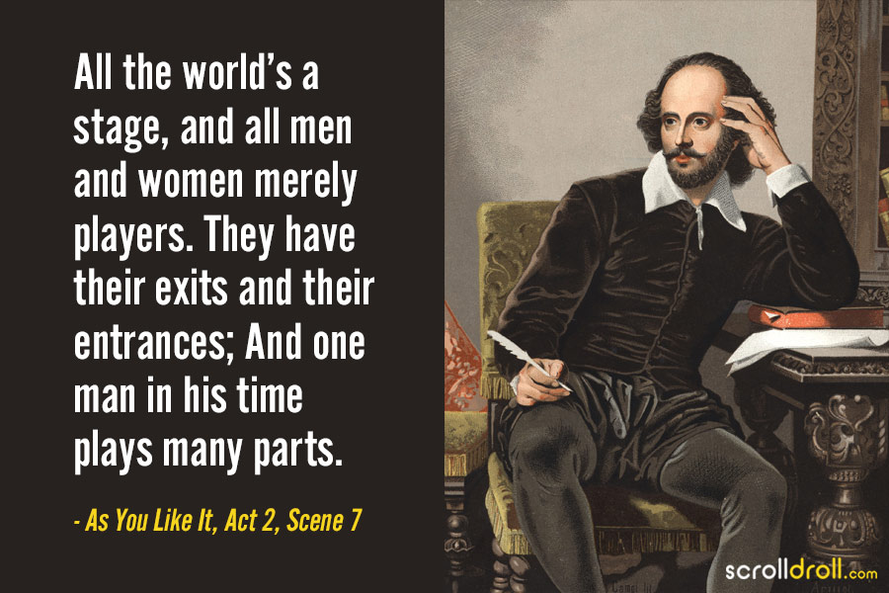
Shakespeare had it Right

Slide 4

Seven Ages/Acts
“Father Time is Undefeated”

Slide 5
Objectives
Case Report- personal journey,…so far.
What was I thinking/planning/doing along the way?
Lessons learned/refined by teaching the next generation
Financial realities-you can retire anytime you want, wherever you want- IF you can afford it.

Slide 6
CASE REPORT
HPI: Subject is a 71 y/o retired Stanford Surgeon
PH:
Finished Grade 29
4 yrs undergrad
4yrs. Medical school
9 yrs. post grad training
First ‘paying job’ at age 34 (and retirement contribution)
Lifelong career in academic surgery

Slide 7
CASE REPORT-Continued
Reasonably solid life/career
Married 43 years, 3 children, 5 grandkids
My RN wife was CEO/COO/CFO of our family/home
Three moves, 5 jobs in 3 institutions
All blessed with good health
Busy clinical pediatric surgeon
Educator/mentor
Investigator-advanced the field
Leader-institutional and external societies/organizations

Slide 8
CASE REPORT -Continued
HPI: Faculty-Stanford University 21 years 1998-2021
Chair Surgery 1998-2015
SIC Packard Children’s Hospital 2002-2016
Co-Director Biodesign 2002-2020
At age 50 planned to stop in OR at age 65, fully retire at 70.
Opted for Stanford FRIP at age 68, OTD at age 70
Loved every minute of the journey
Moved to Austin TX Dec. 2020 for next adventure!
part time venture partner, 8 BOD ( 2 public, 2 NFP, 4 early stage med tech)

Slide 9
Objectives
Case Report- personal journey,…so far.
What was I thinking/planning/doing along the way?
Lessons learned/refined by teaching the next generation
Financial realities-you can retire anytime you want, whenever you want IF you can afford it.

Slide 10
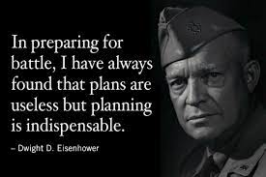
PLANNING

Slide 11
WHAT WAS I THINKING?
Big Influences
Mental model of Life as a Decathlon
Lessons of Surgical Morbidity/Mortality Conference
Don Kennedy’s book Academic Duty
    The flip side of the ‘Academic Freedom’ coin

Slide 12
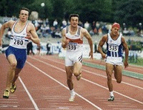
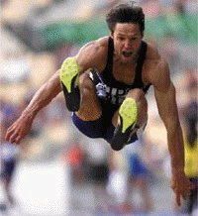
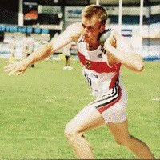

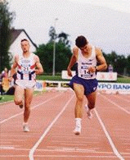
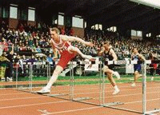
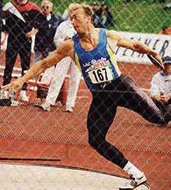
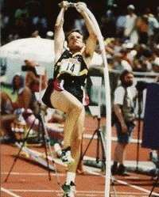
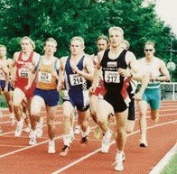

100 metres
Long Jump
Shotput
High Jump
110m Hurdles
400 metres
Discus Throw
Javelin
Pole Vault
1500 metres

Slide 13
DECATHLON AS A METAPHOR FOR LIFE
Objective test of all around ability
Must do well in all
Concessions must be made
Compete against one’s own abilities and standards
Decathlon mentality
  Consistent focus
  Shrug off disappointment
  Constant improvement
  Struggle is with time, distance, fatigue and one’s self

Slide 14
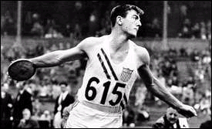
Bob Mathias competed in the Rose Bowl
and in the Olympic decathlon in the same year
One of Stanford’s finest athletes - ever

Slide 15
TMK DECATHLON OF LIFE
10 Events
Human Being Clinician
Spouse Educator Jock
Parent Investigator World Citizen
Leader
Manager
Same principles apply
All round, can’t scratch in any event

Slide 16
KEY principle
Multiple roles avoids risk of narrow self definition
The work is what I do,… but it’s not who I am
Human Being, not a Human Doing
Easier when some roles evolve, bedrock of self/family remains

Slide 17
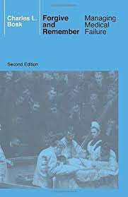
Surgical Morbidity/Mortality mindset
Systematic weekly review of failures
What didn’t work? How to react/rescue/avoid?
Privileged to observe many colleague retire
More that one way to fix an esophageal atresia, or to retire
Some general principles
very few surgeons retired too early
more than a few too late,… many without a plan

Slide 18
Career Planning
During Undergrad we prep/plan for Medical School
During Medical School we prep/plan for Residency training
During Residency we prep/plan for Fellowship
During Fellowship, we prep/plan for Faculty positions
We plan as we move up the ranks and/or move to take ‘next great job’
So why on earth wouldn’t we plan/prep for life after career sunsets
The NEXT act.

Slide 19
“RETIREMENT”
The NEXT ACT
A chance to drive a personal agenda/allocation of time/energy
Calendar control for what matters to you and your family
(I no longer go to Exec Committee every Friday from 1-3PM ! ☺)
Doing what you want to do
with people you want to associate
when you want to-tempered by commitments
What you choose to do, IS personal and will evolve
Doesn’t mean not ‘working’

Slide 20
The future is not a result of choices among
alternative paths offered by the present, but a
place that is created - created first in the mind
and will, created next in activity.
The future is not some place we are going to, but
one we are creating. The paths are not to be found,
but made, and the activity of making them, changes both the maker and the destination.
- John Schaar, Futurist
UC Santa Cruz
A Way to think about pathfinding

Slide 21
GUIDING PRINCIPLE THROUGHOUT
Failing to plan,…means planning to fail!
Useful strategy
personal, professional
OR
patient care
trainee career training/mentoring (lifelong)
couple athletic events

Slide 22
PERSPECTIVE
1. Everything WILL change, in uncertain ways.
2. Can’t possibly be a proscriptive solution.
3. Stay agile, alert.
4. “In times of drastic change, the learner inherits
the future. The learned find themselves equipped to live in a world that no longer exists.” - Eric Hoffer

Slide 23
Objectives
Case Report- personal journey,…so far.
What was I thinking/planning/doing along the way?
Lessons learned/refined by teaching the next generation
Financial realities-you can retire anytime you want, whenever you want IF you can afford it.

Slide 24

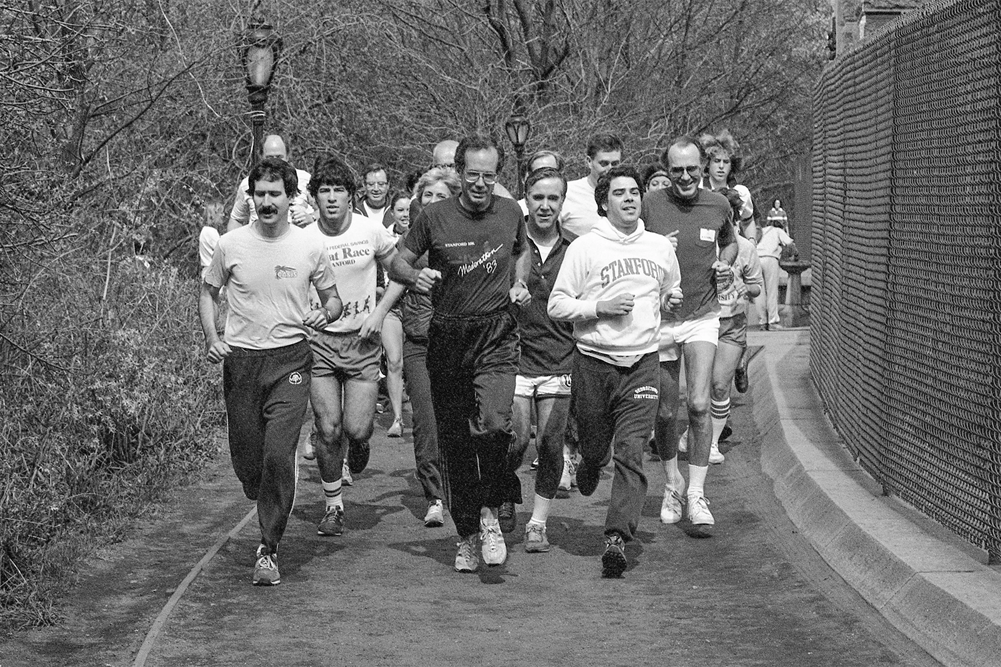
Academic Freedom/Academic Duty
Donald Kennedy-Stanford’s Eighth President

Slide 25
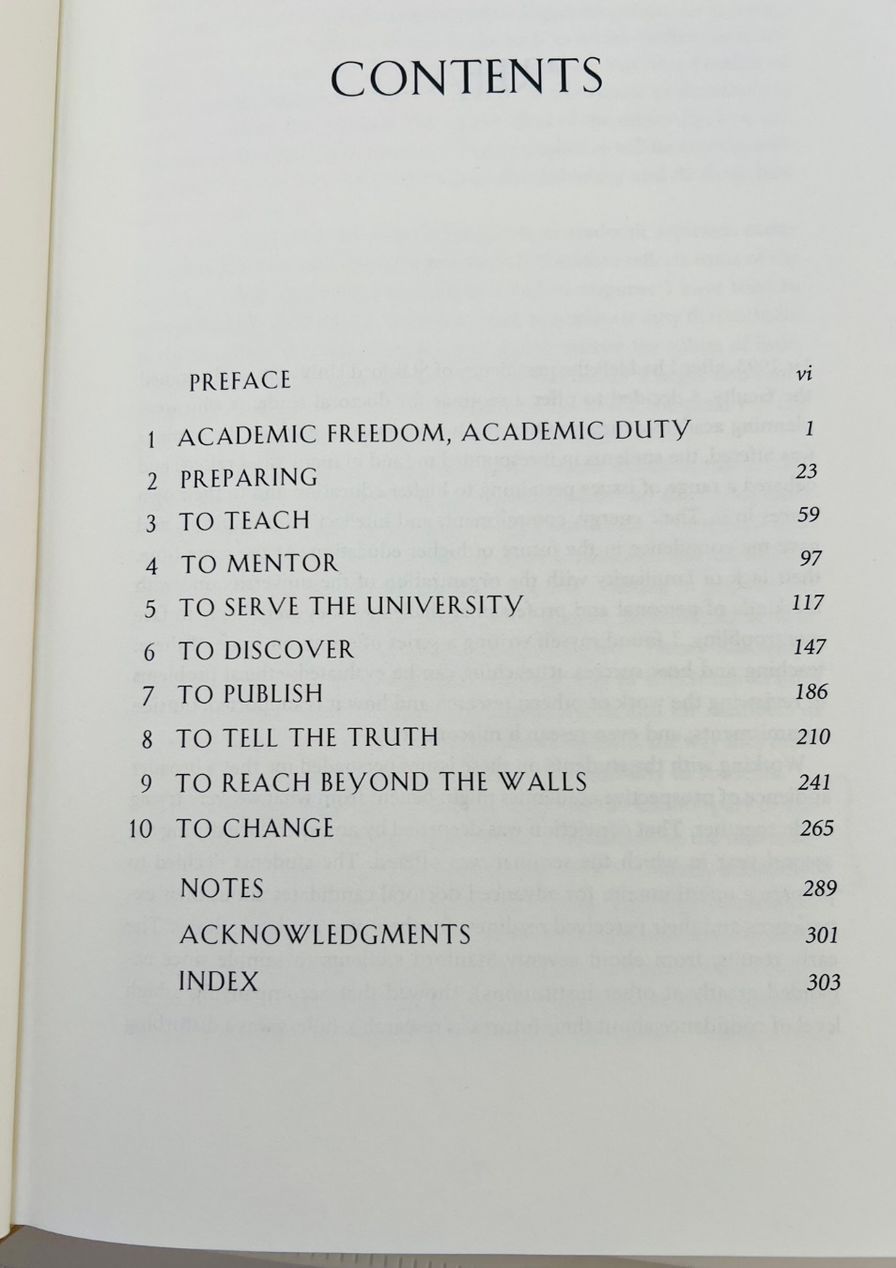
Academic Duty

Slide 26
Recurring theme of Academic Duty
‘pay it forward’
Preparing the next generation to replace you
To teach
To Mentor
To Change
____________________________________________________
We were teaching the next generation of surgeons a priceless set of skills, and the ability to generate a fair bit of money with those skills. What to do with that money?- notoriously unprepared

Slide 27
LIFE / WEALTH PLANNING
for Trainees
20 YEARS Experience
Presented by:
Thomas M. Krummel, MD
Emile Holman Professor and Chair Emeritus
Department of Surgery, Stanford University
Co-director, Stanford Biodesign
Fellows Seminar Series
18 November 2020

Slide 28
DISCLAIMER
I am not A Financial Advisor
Have made my share of mistakes
Think of this as financial M & M conference
Don’t ignore your finances - classic doc/scientist error
You can learn this stuff - it ain’t Rocket science/Surgery
- but, you do need expert consultations
Big time leverage of your priceless skills

Slide 29
WEALTH MANAGEMENT
“Wealth” ain’t all about $
      Personal Health
      Family
      Friends
      Professional Satisfaction
So:
      Find a job you love
      Pay attention to your family every day
      Eat right, watch alcohol
      Work out regularly
      Don’t smoke
      Wear your seatbelt

Slide 30
The Non-Taxable Compensation
PROFESSIONAL SATISFACTION
Call from trainee: “Passed my Boards”.
College graduation announcement from my first EA/TEF repair.
Zoom meeting with 2nd ECMO survivor on his 40th birthday.
Careers/success of trainees, colleagues and friends.
Can’t BUY any of this at Neiman’s*
* Arnold Salzberg

Slide 31
Trainees REALITIES 2020
Completing | 4 years medical school
 | 7-10+ years postgrad education / experience
 | —you will probably finish ”Grade 30!”
Age 28 – 40 | Savings ?
 | Home equity ?
 | Retirement contribution ?
 | ? Large debt ?

Slide 32
The Krummel ‘Grid’
A macro look at planning next 40 years of your life
- those will go faster than you think
Provide predictable perspectives on life events
- kids, educational realities, weddings, retirement
- envision your professional career against that backdrop
A planning tool to set/achieve goals
- you can’t save for kids college when they are a HS junior!
A framework to discuss with your partner/family economic realities
- facilitate hard but essential conversations

Slide 33
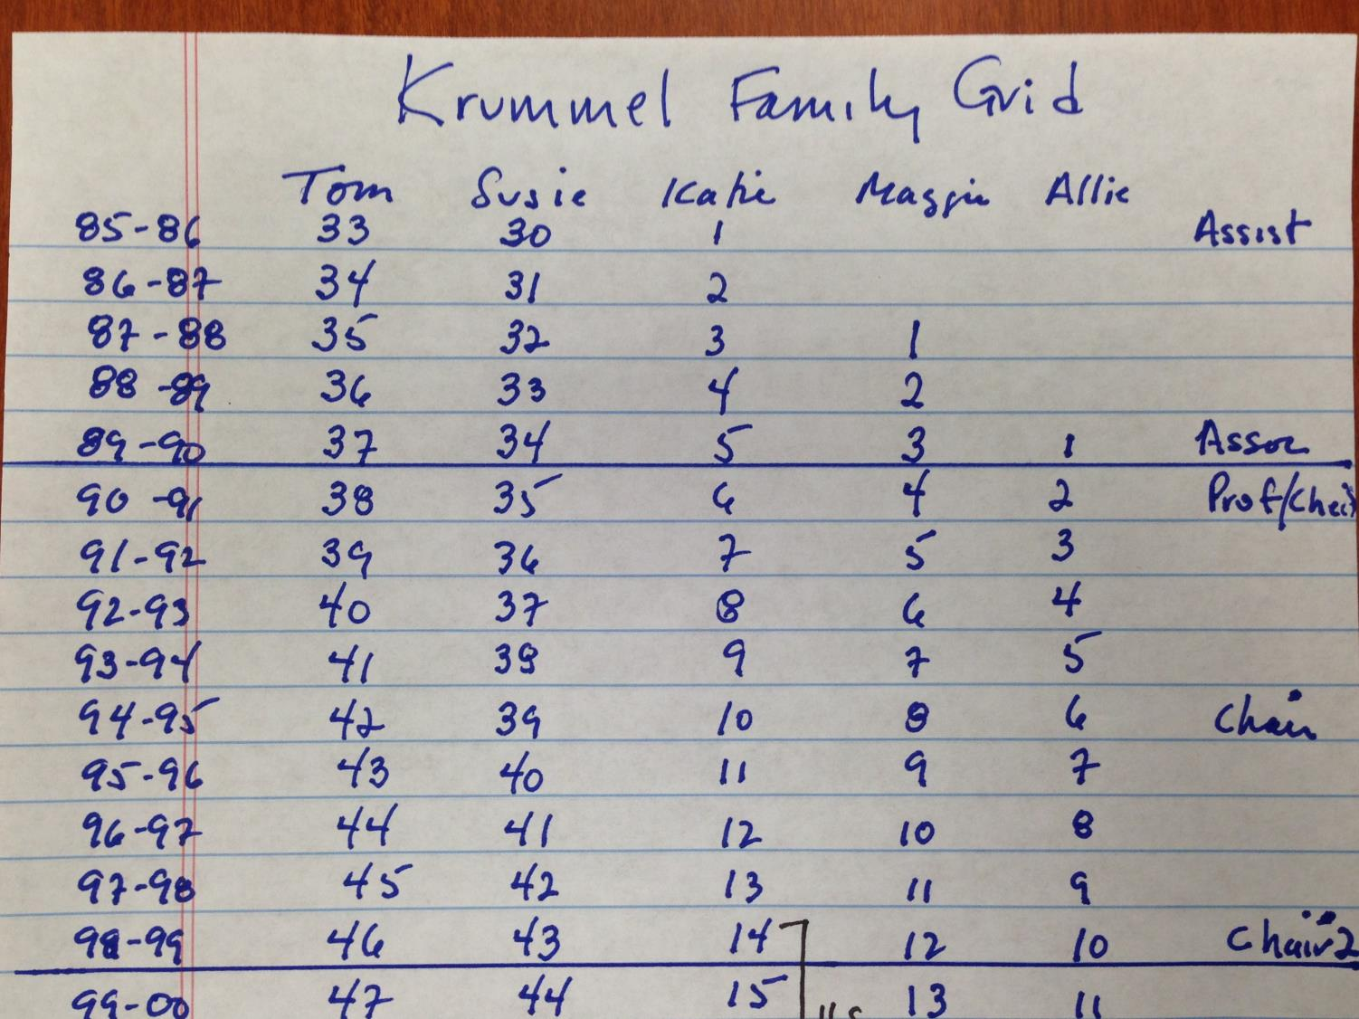

Slide 34
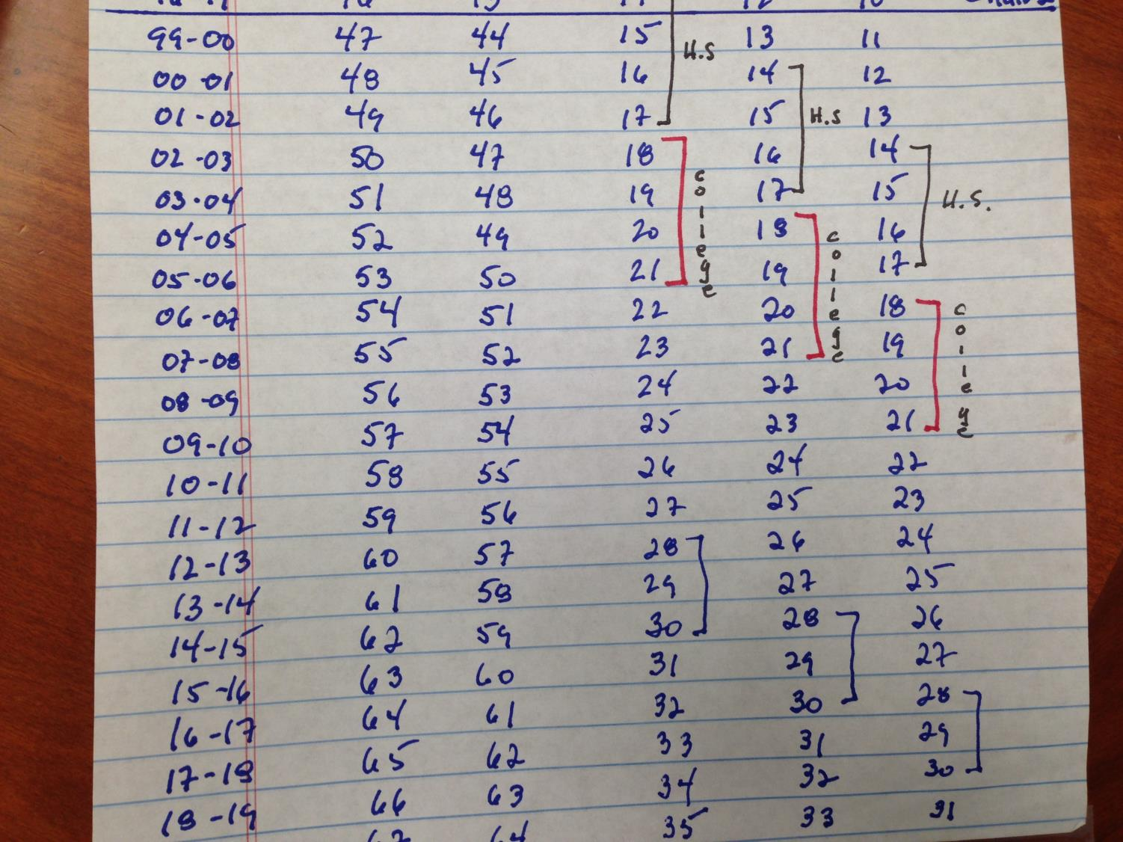

Slide 36
THINGS FOR YOU
TO GET CLARITY ON
What is your self view?
What is your mission, vision? How does calendar synchronize?
What matters to you and family?
What is your North Star?
… If you can fill the unforgiving
minute with sixty seconds worth
of distance run …
- Kipling

Slide 37
FINANCIAL PLANNING BASICS
TRUST ME !
Assume you work full time for 30 years
Annual 30 yr 30 yr 30 yr Nest Egg
Income Gross Tax Net Income (Optimal*)
$100K $3.0M $1.2M $1.8M $2.0M
$250K $7.5M $3.5M $4.0M $ 5M
500K 15.0M 7.0M 8.0M 10M
Rough estimates but real, no inflation
* Retirement income equals annual income in perpetuity

Slide 38
HOW TO GET THERE ??
− Debt elimination
− Protection
− Taxes
− Retirement savings/investment
− Kids/Education savings/investment
− Home-real estate investment
Articles
- Poor Richard’s Almanac
- Wall Street Journal (WSJ)

Slide 39
Advice to a Young Tradesman 1748
The Sound of your Hammer at Five in the Morning or Nine at Night, heard by a Creditor, makes him easy Six Months longer. But if he sees you at a Billiard Table, or hears your Voice in a Tavern, when you should be at Work, he sends for his Money the next Day.
Remember that Money is of a prolific generating Nature. Money can beget Money, and its Offspring can beget more, and so on. Five Shillings turn’d, is Six: Turn’d again, ’tis Seven and Three Pence; and so on ’til it becomes an Hundred Pound. He that kills a breeding Sow, destroys all her Offspring to the thousandth Generation. He that murders a Crown, destroys all it might have produc’d, even Scores of Pounds.
The Miracle of compounding interest

Slide 40
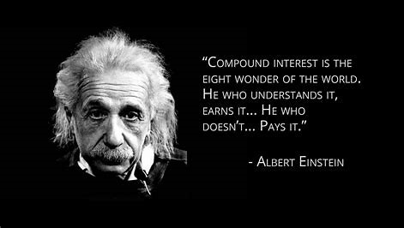
Lessons from Einstein

Slide 41
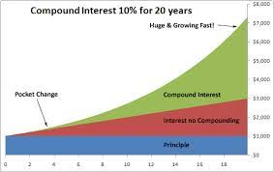

Slide 42
DEBT
Pay if off as fast as possible, unless low or no interest
Pay off credit cards = 18+%
Time value of money can work for you
or
Miracle of compound interest against you

Slide 43
KEY LESSONS
No one can do this but you/spouse/partner
- Set aside 1 hour/week
You do need professional consultation
- CPA
- Financial Planner
- Attorney
Remember – they all are selling something; no free lunch
Continual self-education
- WSJ
- Fortune, Forbes
- Professional Societies

Slide 44

TWO THINGS ARE CERTAIN

Slide 45
TAXES
IRS doesn’t take a joke
Plan all year – makes April 15 tolerable
Taxes at all levels
- Federal
- State
- Local
- Sales
- Others
Get to know a CPA ASAP

Slide 46
PROTECTION
Wills, Power of Attorney, Trusts – Find a lawyer
Life Insurance
Term: | - Pure protection - Death benefit only - No investment piece - Cheap
Whole Life: | - Protection & investment - More expensive
Two – five times annual income
Disability Insurance
- 66.66% of income - Occupation specific - 3-12 month delay
Check your employment benefits

Slide 47
RETIREMENT/KIDS
Couples fight most about:
kids and money
Remember the Airline Message:
In case of an emergency -
put on your oxygen mask first,
then assist your child

Slide 48
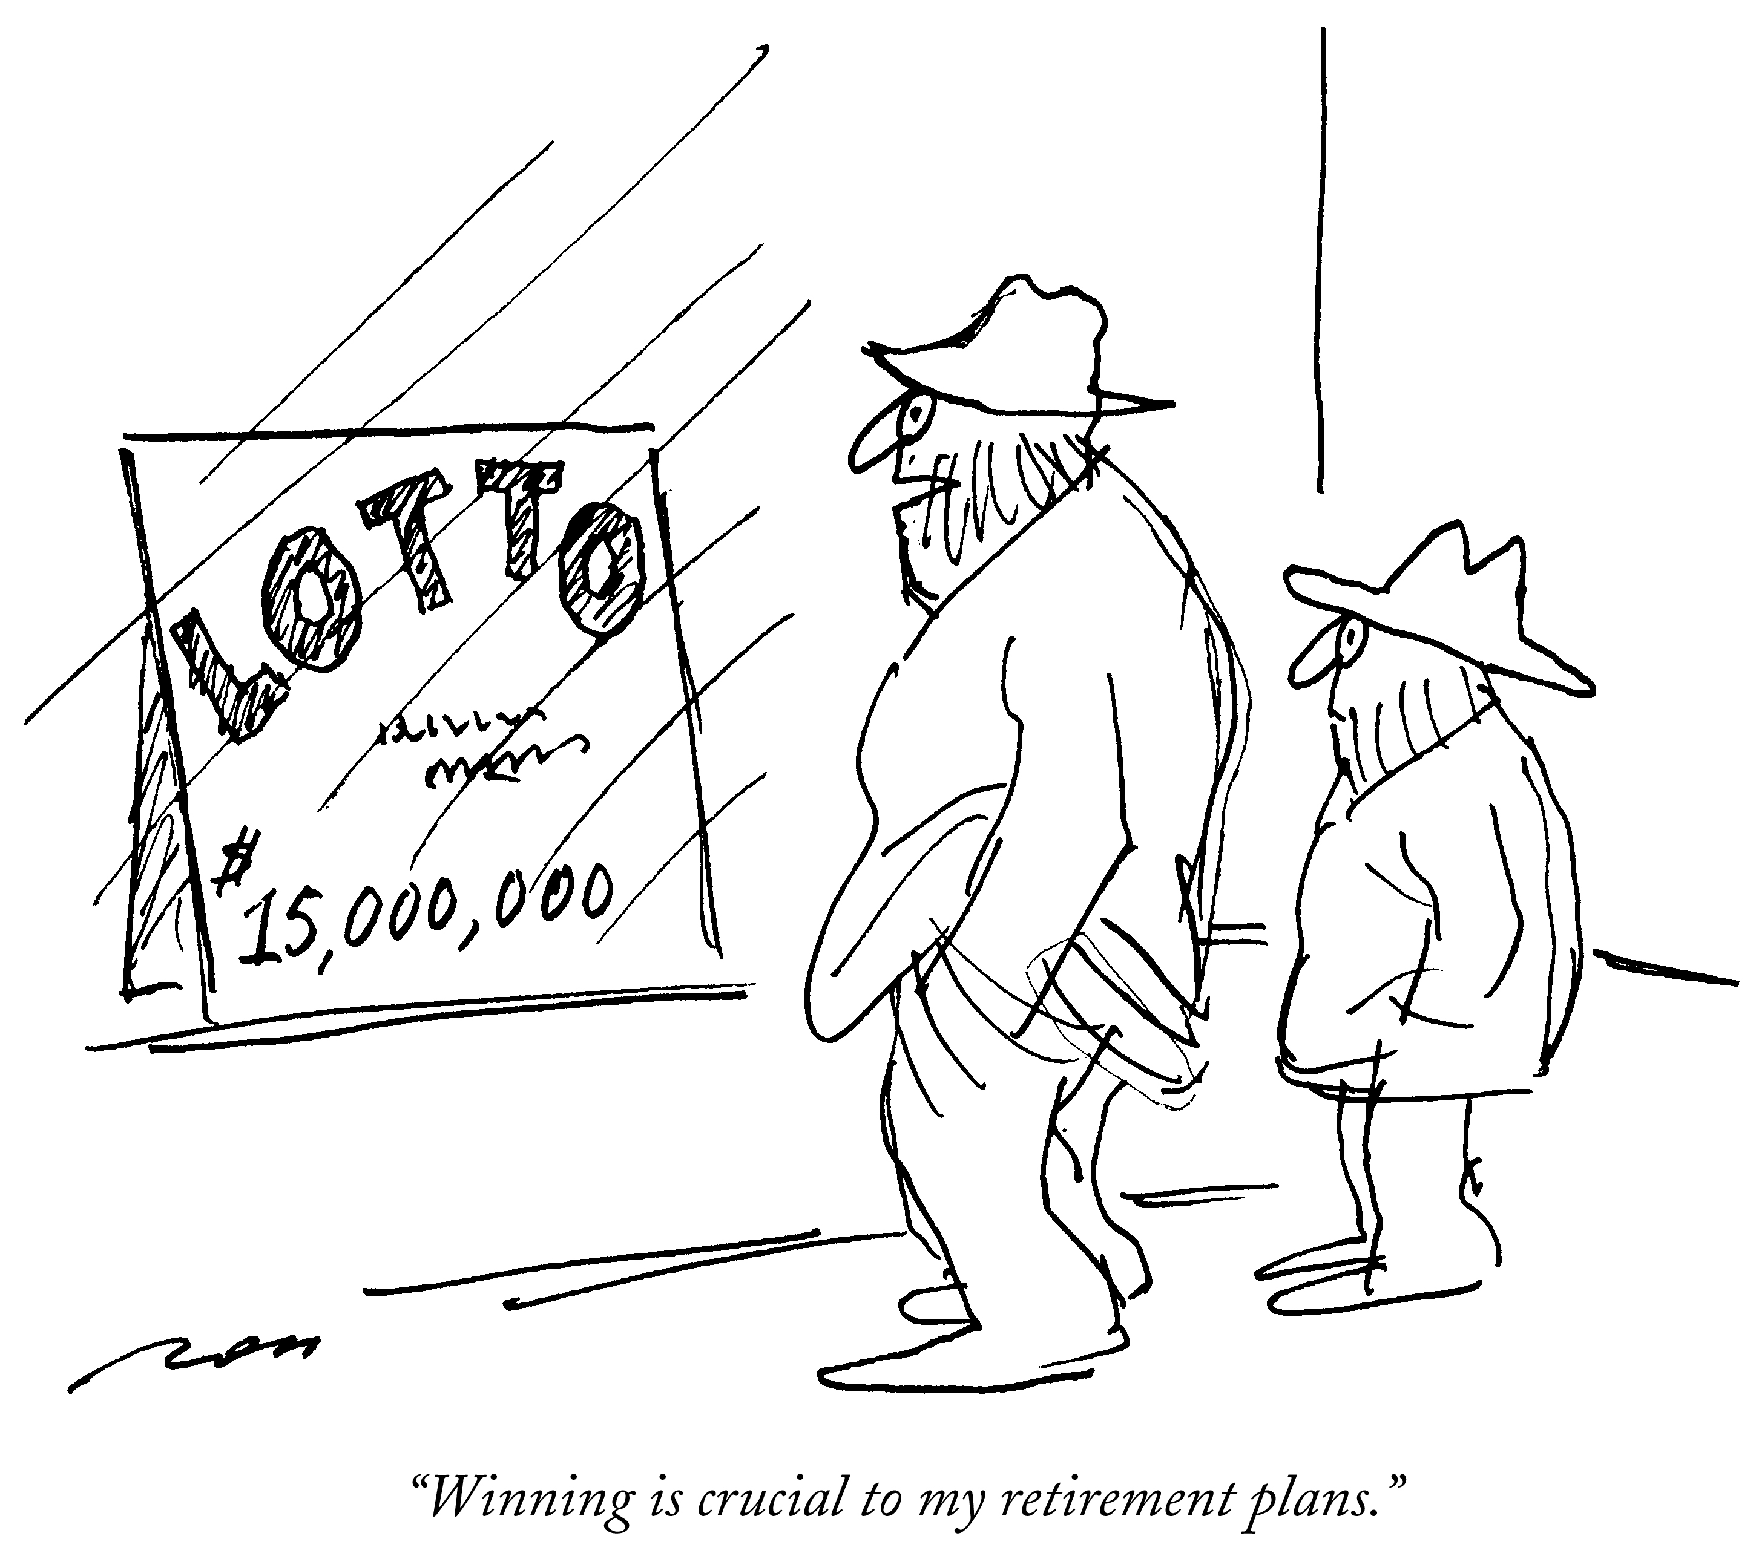
Just like in the practice of Surgery, HOPE is not a strategy!

Slide 49
RETIREMENT
House - own or rent, maintenance, taxes
Fixed income
Social Security - will provide $25-30,000. annual
80-100% of your annual salary is what you will want
Diminishes over time/age
Key Strategies
- Pay yourself first
- Consistency
- Understand risk/reward and volatility
- Understand how your practice plan contributes/matches
When is the time to plan?

Slide 50
KIDS
$250K-$1.0M each total
Education: $45K/year x 4 years = $180K
Start now: Investment account
Zero coupon bonds
Can borrow for education
Can’t borrow for retirement

Slide 51

HOME
You have two choices:
Buy or Rent
See WSJ article:
  Conventional Wisdom (CW)
  It’s okay to question (CW)
  Value of continued reading/learning

Slide 52

CONCLUSIONS
Start Now
Talk to your spouse/partner
It is up to you two
Professional consultants
- get the best
- listen and learn
- question/stay informed

Slide 53
Objectives
Case Report- personal journey,…so far.
What was I thinking/planning/doing along the way?
Lessons learned/refined by teaching the next generation
Financial realities-you can retire anytime you want, wherever you want IF you can afford it.

Slide 54
A few general thoughts
Average faculty member is not financially independent
In 21st century, most will have defined contribution plan, not defined benefit plan
Take every employer 401 K matching dollar-it is FREE money
Financial independence is Freedom to discover, explore and enjoy your next act

Slide 55
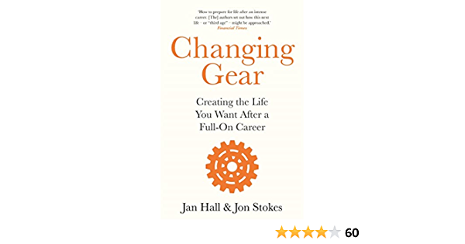
A Useful Read
“To exist is to change, to change is to mature, to mature is to go on creating oneself endlessly.” Henri Bergson

Slide 56
A Little Confirmation Bias
“Think of all the time people spend deciding which University they would like to attend, which courses they will study and the careers they will pursue.
Deciding on their post-career lifestyle is just as important
They (you) may have decades to enjoy!”
Book Review: Bartleby in The Economist April 17, 2021
“Stepping Down is Hard to Do”

Slide 57
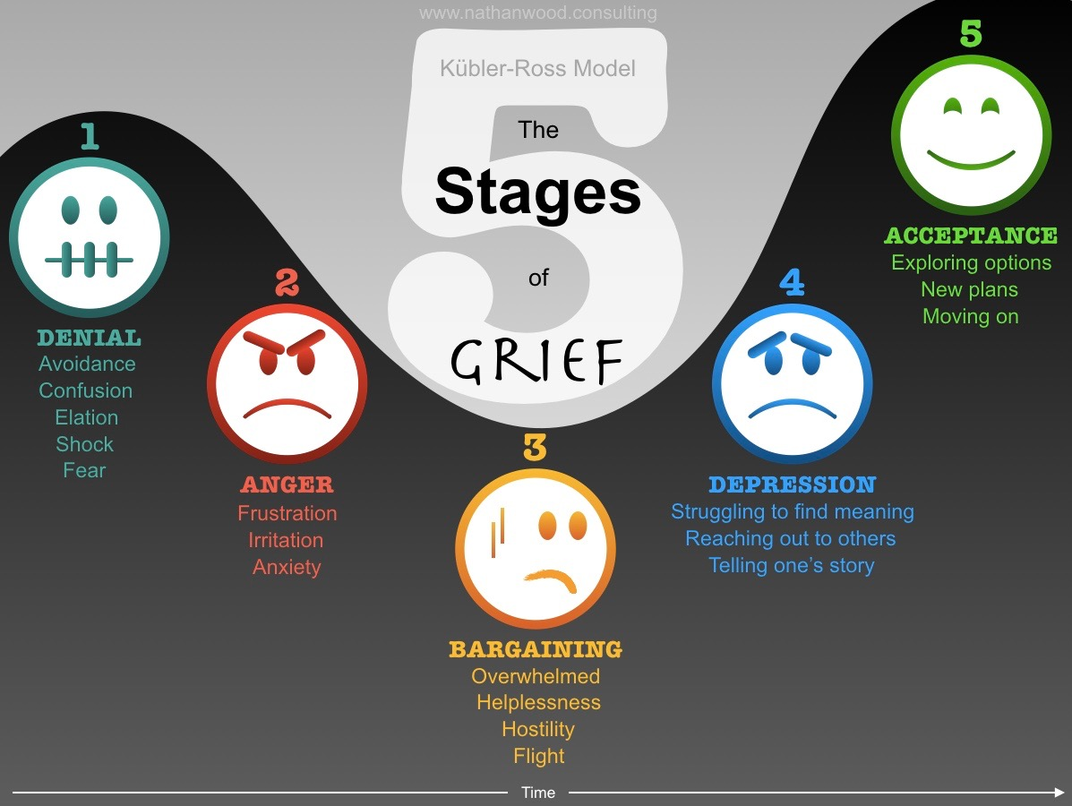
Kubler Ross was RIGHT

Slide 58
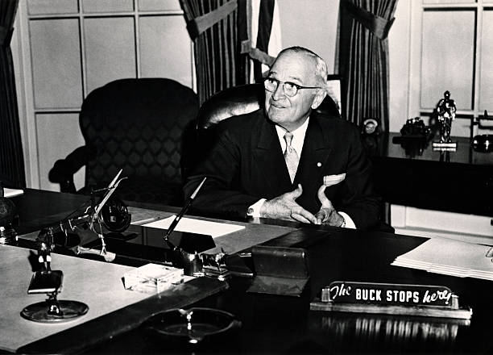
Can be a Convulsive Seismic Shift
“Two hours ago, I could have said 5 words and been quoted in fifteen minutes in every capital of the world.
Now I can talk for 2 hrs. and nobody gives a damn! “
Harry Truman shortly after leaving office ☺

Slide 59
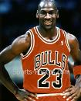
YOU WILL SCREW UP
FAILURE
In my career:
I have missed 9,000 shots.
I have lost >300 games.
Twenty-six times I have been trusted
to take the game-winning shot …and missed.
I have failed over & over & over again.
Michael Jordan
But I never quit … and that is why I succeed.

Slide 60
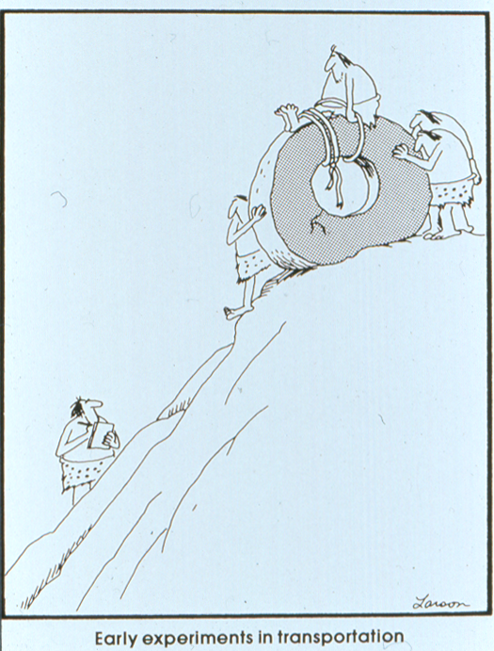

Slide 61
Retirement Financial Reality
If you think Social Security will suffice
Consider
I made max contributions for 40 years
Delayed first draw until 70+
Monthly gross $4125.
less Medicare (578)
Net $3547.
First ten years retirement you will (want to) spend like last 5 years
Don’t tend to spend when you are working

Slide 62
FINANCIALS: Planning Basics
Assume you work full time, post training for 30 years:
ANNUAL | GROSS | TAX | NET | NEST EGG (NEED)
$250K | $7.5M | $3.5M | $4.0M | $5M
$500K | $15.0M | $7.0M | $8.0M | $10M
$750K | $22.5M | $9.0M | $13.5M | $15M
Rough estimates but real
No inflation
Retirement income equals annual income in perpetuity

Slide 63
Corollary
Financial planner
Dr. X, yes you can afford to retire at age 65
you’ll just need to die at age 70
Bagging your own groceries must not be job training for retirement

Slide 64
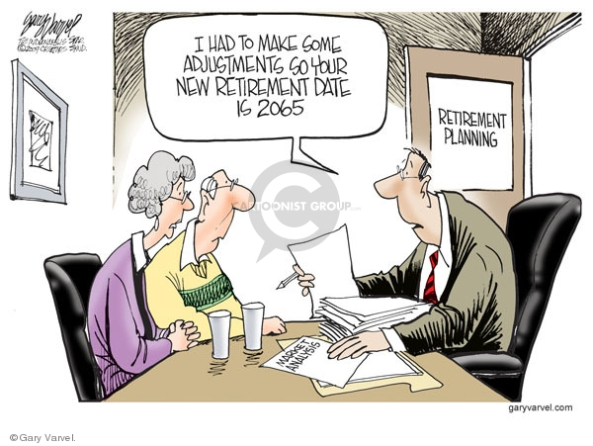
Try to avoid this situation

Slide 65

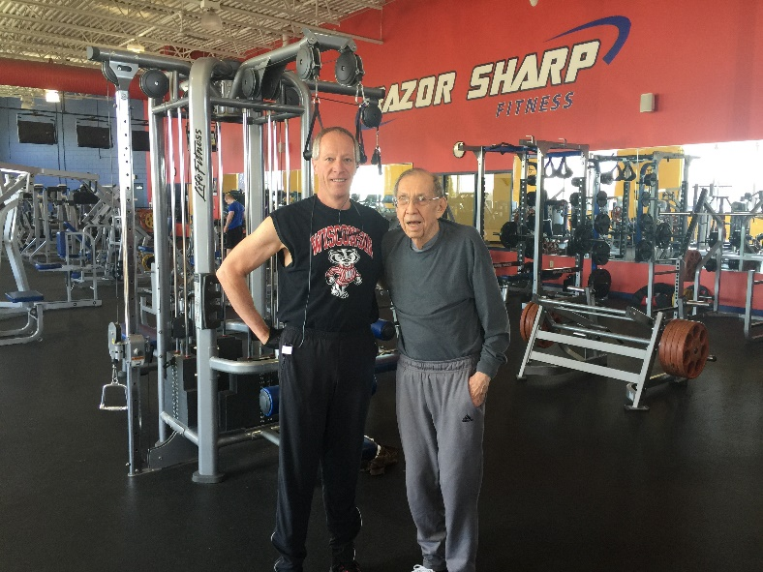
The Wealth of Health
Aging is inevitable, decay is a choice
One of my Decathlon events is Athlete
Most everybody ‘gets’ cardio
Don’t ignore flexibility
Strength/balance training is essential

Slide 66
Conclusions
Case report, personal journey-so far. Remember: N= 1
Start planning retirement (your next act ) Day 1 of Job 1
  Or at least Today
Plans may change or become useless, but planning is invaluable
The game WILL go on,… without you. So find your next game
The freedom to find next game(s) requires solid financial planning

Slide 67
REFERENCES
Hubbard, L.: “Financial Security: Lessons Not Taught in Medical School”, General Surgery News, Dec 7, 2020.
Harris, E.: “In Their 20s and Saving for Retirement: How It Started, How It’s Going”, New York Times, Nov 27, 2020.
Franklin, B.: “Advice to a Young Tradesman”, thoughts by Benjamin Franklin from Poor Richard’s Almanac, or from his letters on life and prosperity.
Farley, DR, van Heerden, J.: “The Surgeon’s 2-minute Guide to Retirement Planning”, Contemporary Surgery, Vol 2:9, Sept 2006.

Slide 68
REFERENCES
Robinson, K.: “Young Scientists Need Firm Plan to Make Up for a Late Start”, Science, Vol 313, Sept 8, 2006.
Mincer, J.: “How to Set Financial Priorities”, The Wall Street Journal, Jan 11, 2007.
Crook, D.: “Why Your Home Isn’t the Investment You Think It Is”, The Wall Street Journal, Mar 12, 2007.
Davidson, L. and Bradley, S.: “How to Pick the Right Financial Planner”, Forbes online, Sept 3, 2010.

Slide 69
REFERENCES
Silver, J.: “How will you get paid?”, PracticeLink Magazine, Fall 2011.
Zeikel, A.: “Managing Your Portfolio: One Father's Advice”, Forbes.com, Jun 18, 2010.
Meehan, M.: “The Mayonnaise Jar and Coffee”, May 29, 2004, Aug 22, 2013, and May 20, 2014.
Abernathy, S. and Luster, B.: “The Slow and Steady Path to Wealth”, PracticeLink Magazine, Fall 2011.

