Slide 1
Do No Harm
A Visual Art Installation by Grace Adebogun

Slide 2
Trailer Introduction

Slide 3
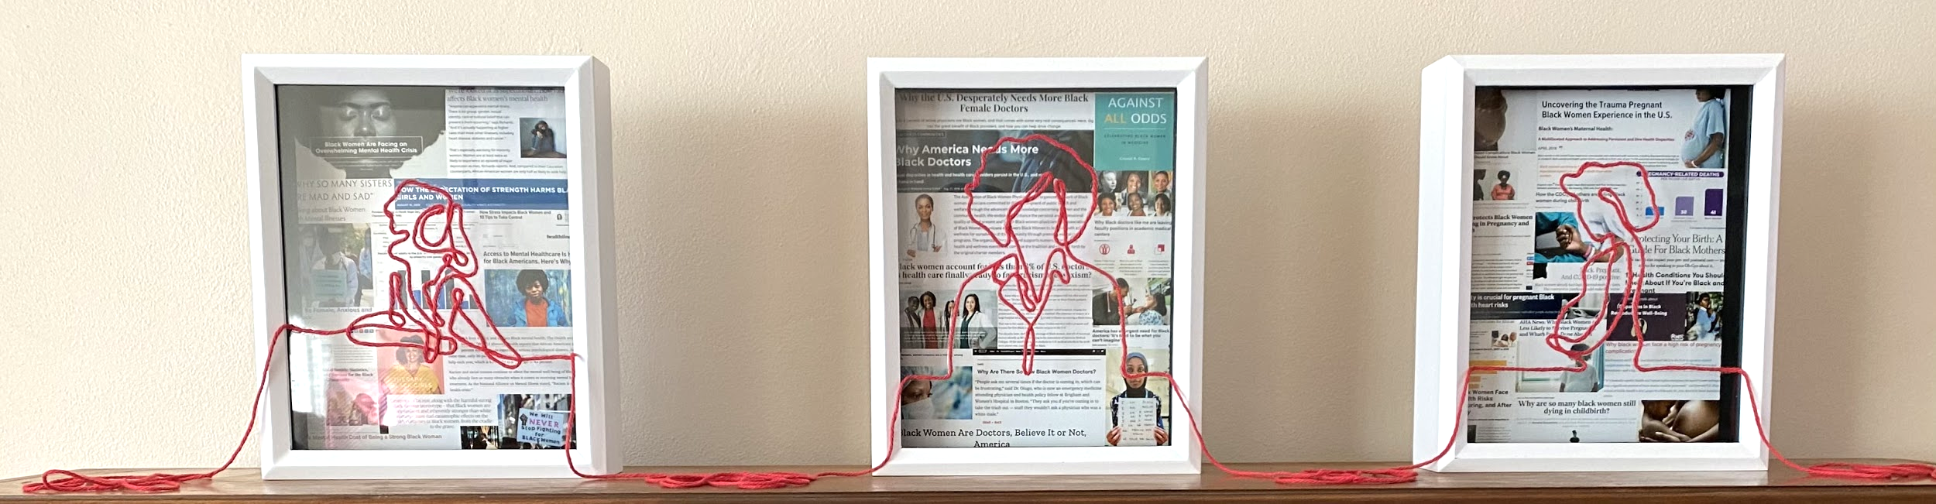
Art Installation

Slide 4
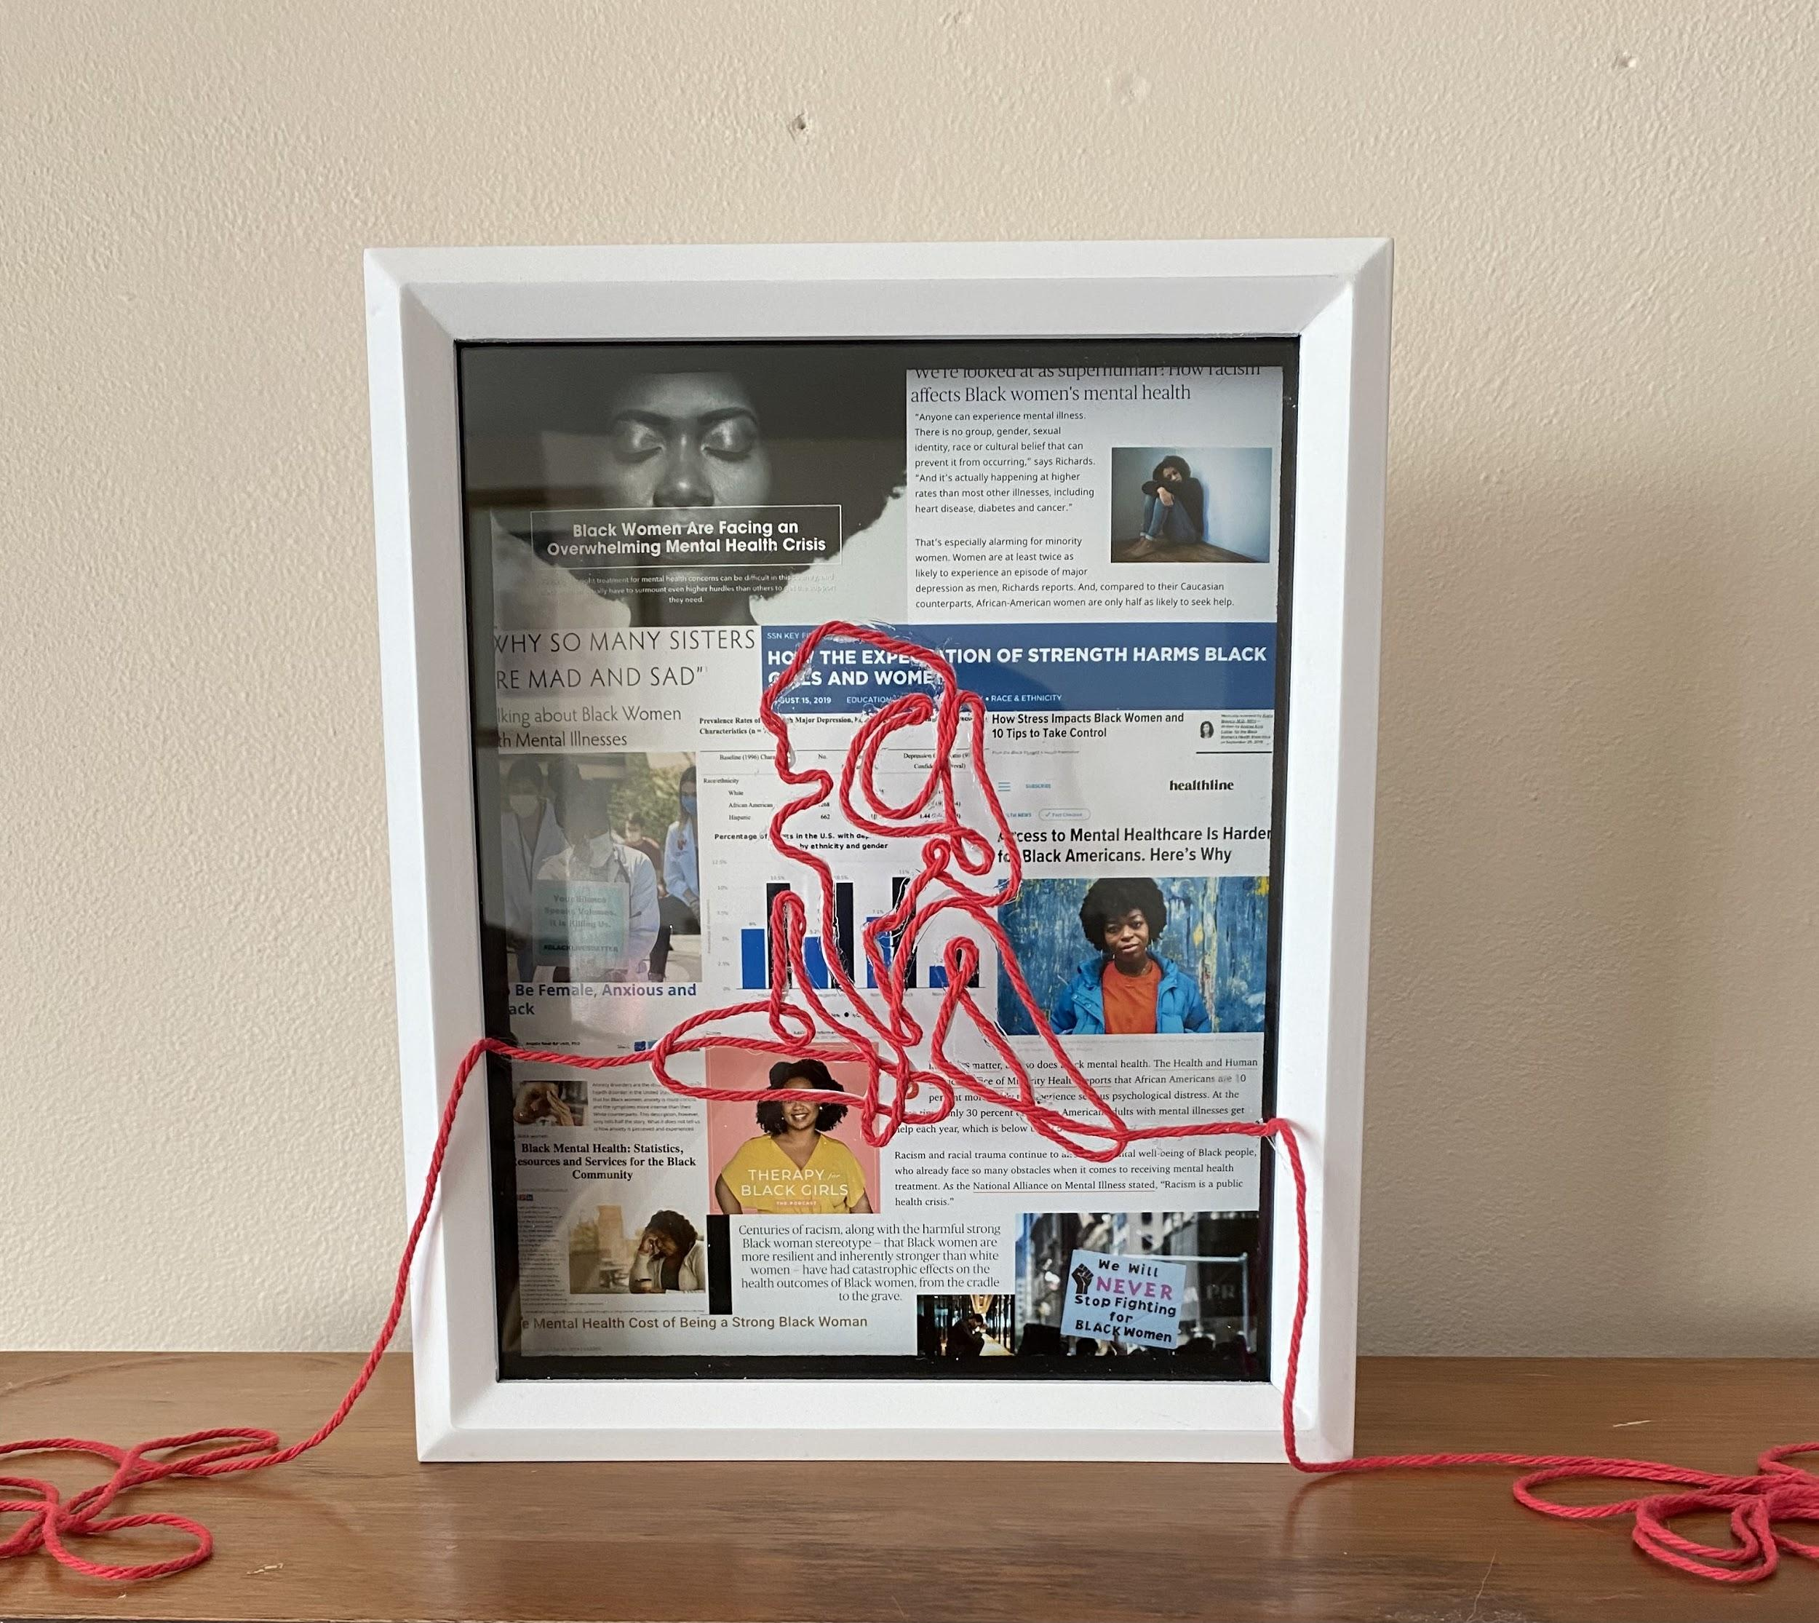
Mental Health
11% of Black Women have depression as opposed to 10.5% of White women
Only 12.9% of the woman population is Black women as opposed to 60% of White women
Notes:
https://www.cdc.gov/nchs/products/databriefs/db303.htm
Line art inspired by: https://www.vectorstock.com/royalty-free-vector/continuous-line-drawing-sitting-sad-girl-vector-19880861

Slide 5
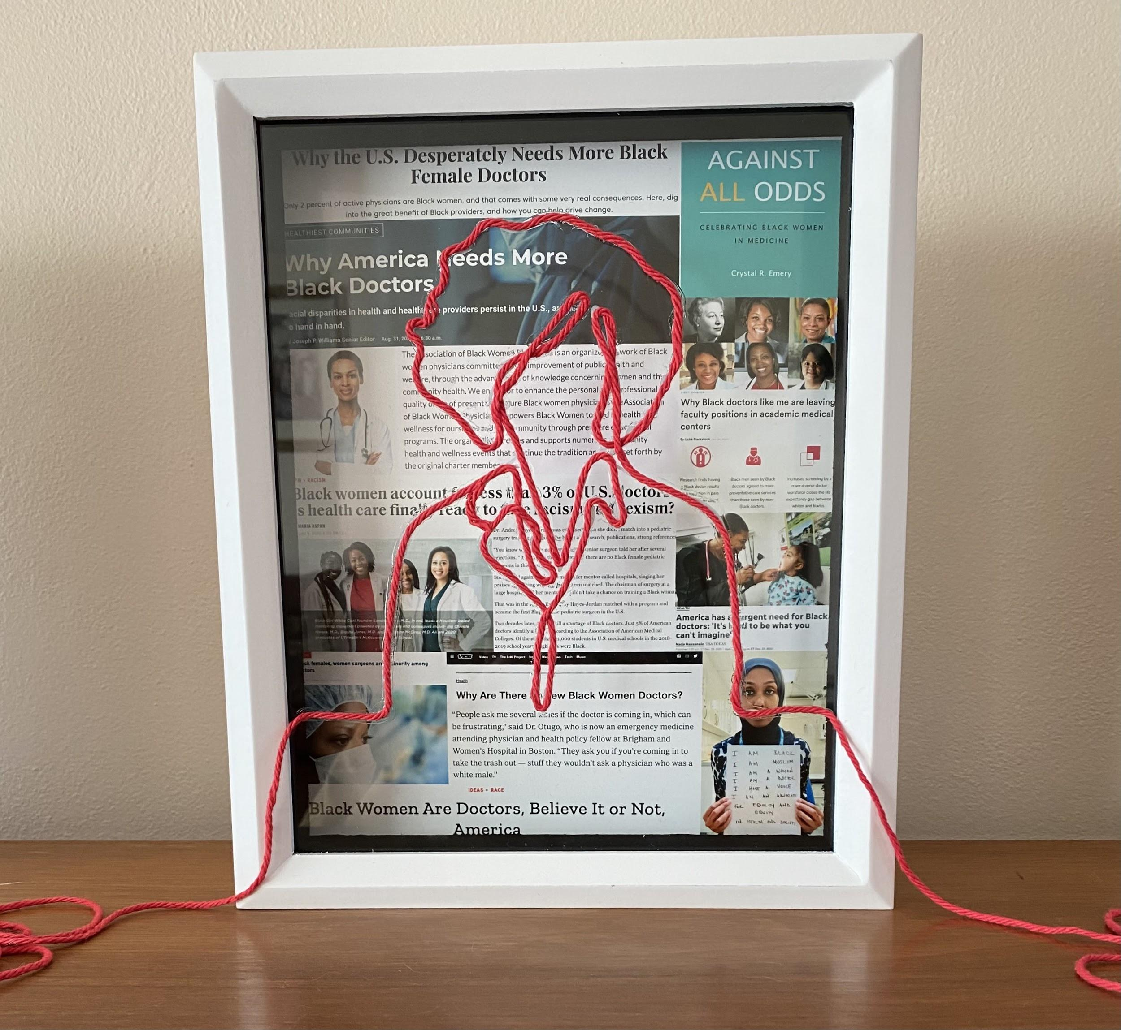
Black Female Doctors
Around 2.6% of doctors are Black women as opposed to 19.3% for White women
Only 12.9% of the woman population is Black women as opposed to 60% of White women
Notes:
https://www.aamc.org/data-reports/workforce/interactive-data/figure-20-percentage-physicians-sex-and-race/ethnicity-2018
https://www.aamc.org/data-reports/workforce/interactive-data/figure-18-percentage-all-active-physicians-race/ethnicity-2018
Line Art inspired by: https://www.shutterstock.com/image-vector/doctor-stethoscope-continuous-line-drawing-629514734

Slide 6
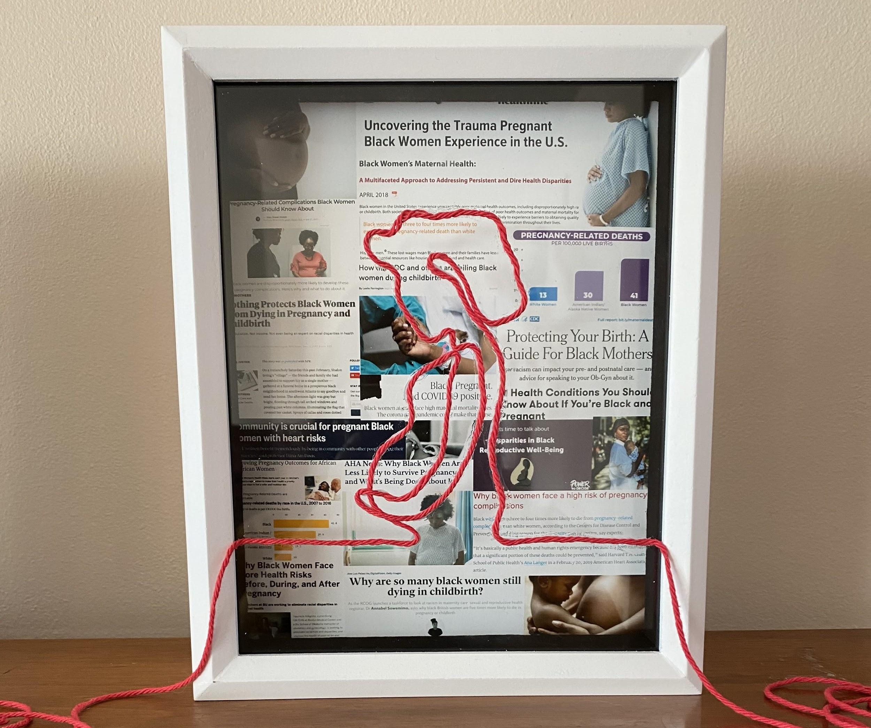
Pregnancy
41.7 out of every 100,000 births result in death for Black women as opposed to 13.4 for White women
Only 12.9% of the woman population is Black women as opposed to 60% of White women
Notes:
https://www.cdc.gov/reproductivehealth/maternal-mortality/pregnancy-mortality-surveillance-system.htm
Line art inspired by: https://stock.adobe.com/ca/images/pregnant-woman-single-continuous-line-art-medicine-health-care-pregnancy-healthy-silhouette-holding-belly-headline-concept-design-one-sketch-outline-drawing-white-vector-illustration/238242794

