Slide 1
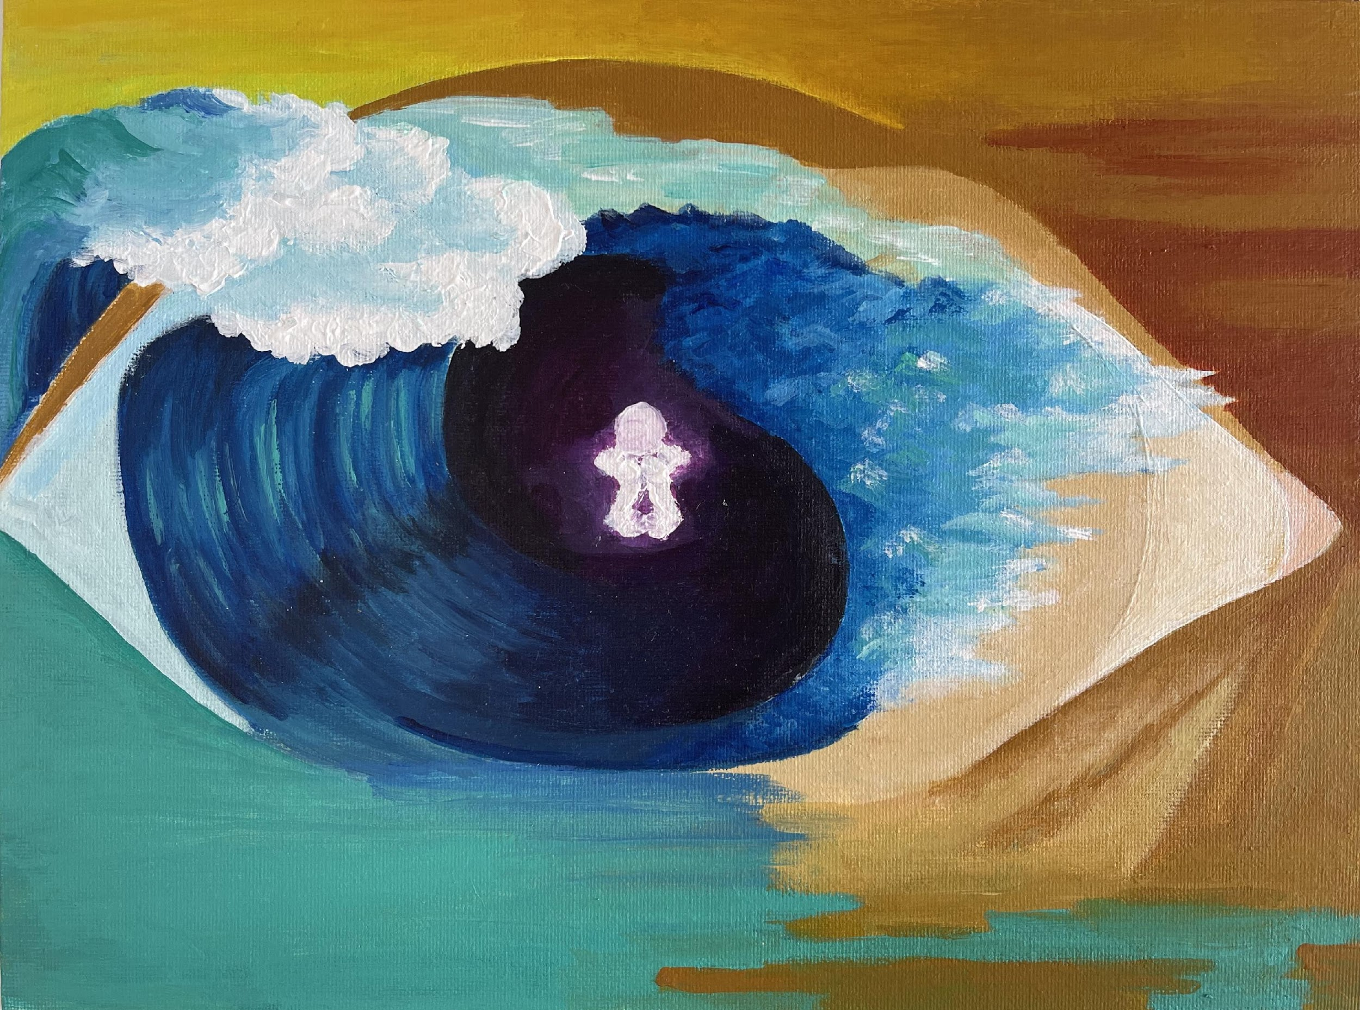
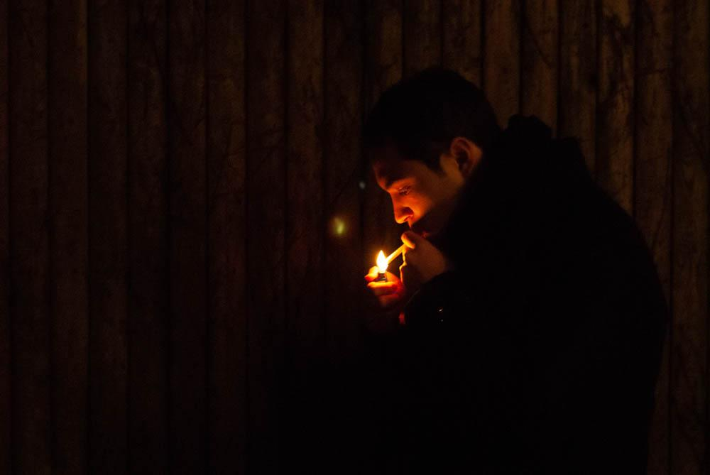
Daily Headache: “Distanced, Vulnerable, Ebbs and Flows”
"If you have something visible, the onus of being sympathetic is on the people around you, and I think if you have something like pain, I think the onus is on you, which makes it more difficult."

Slide 2
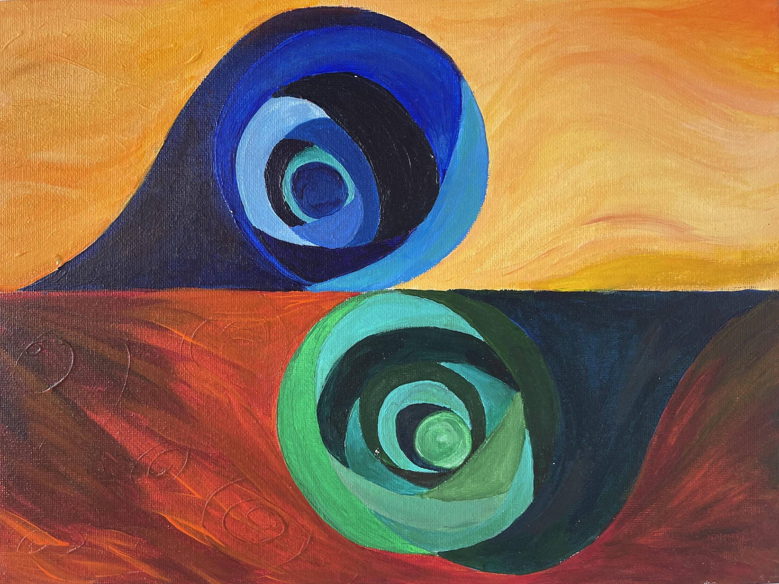
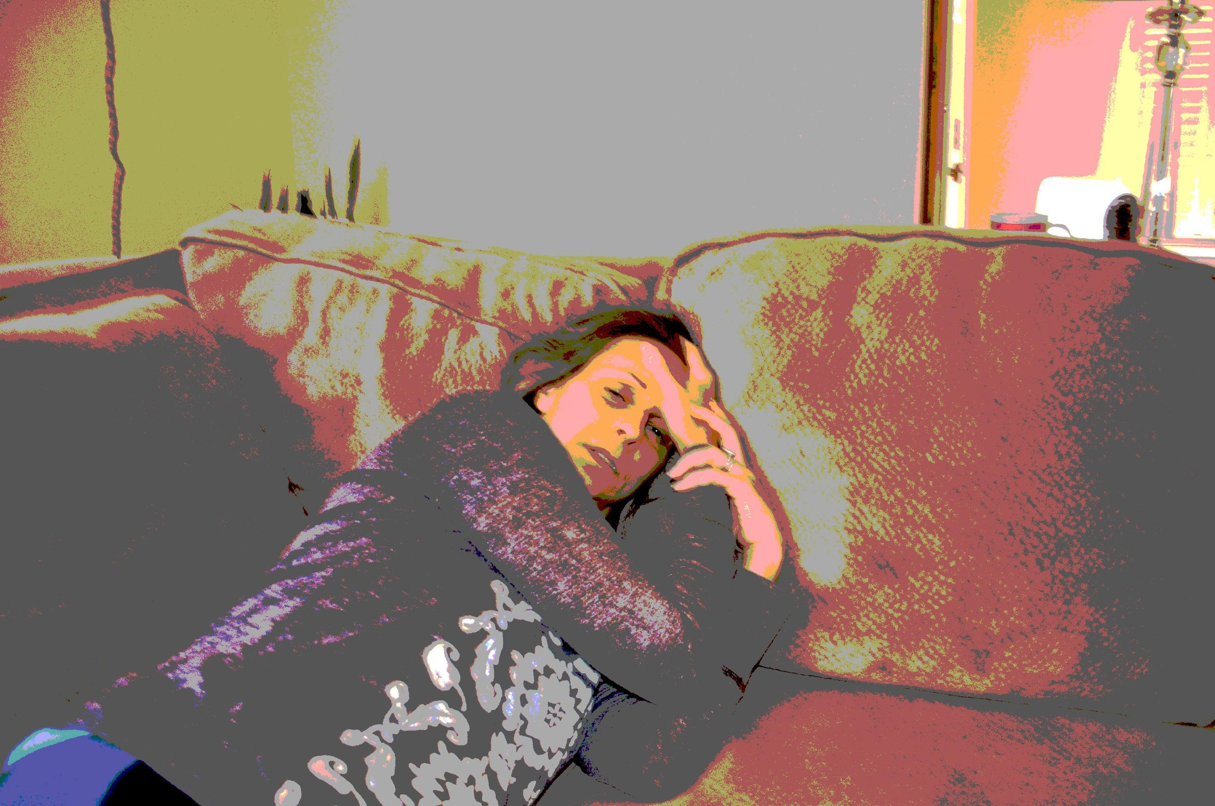
Migraine Headache: “Violent, Welcoming, Wisps”
"I have to practice every single time I go down the dark tunnel. I have to say to myself every time, 'This is the migraine talking. Don't believe it. Your life isn't awful. You're not depressed. This is the migraine attack...' And I have to tell myself that every time."

Slide 3
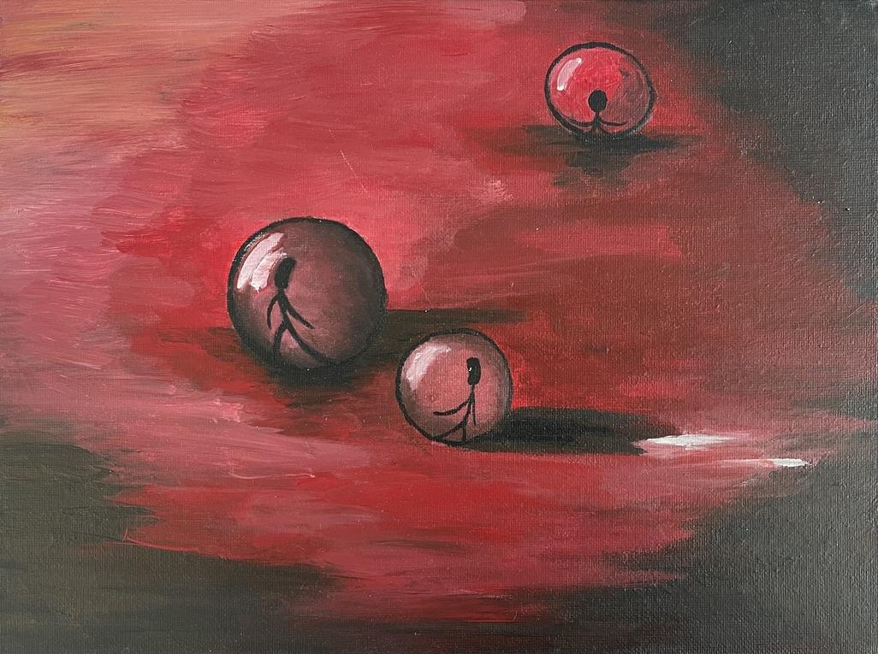
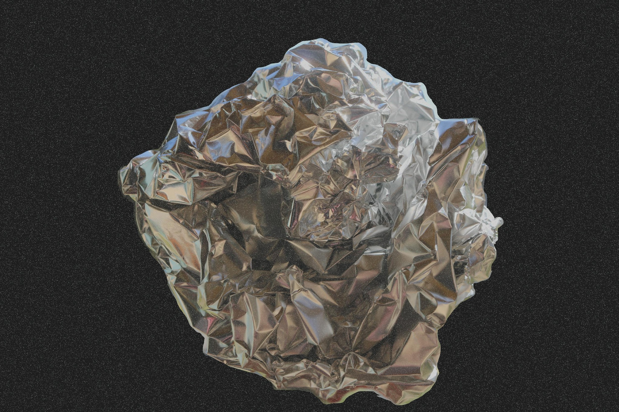
Migraine Headache: “Burrow, Threat, Confined”
“You feel like you have an invisible handicap [but] you don't know when it's going to happen. It's like you're walking and all of a sudden, there's a glass window in front of you that you knocked into. And, all of a sudden, you've crashed and you're like, 'Okay well I guess I've got to stop going this way and I've got to go that way.' "

Slide 4
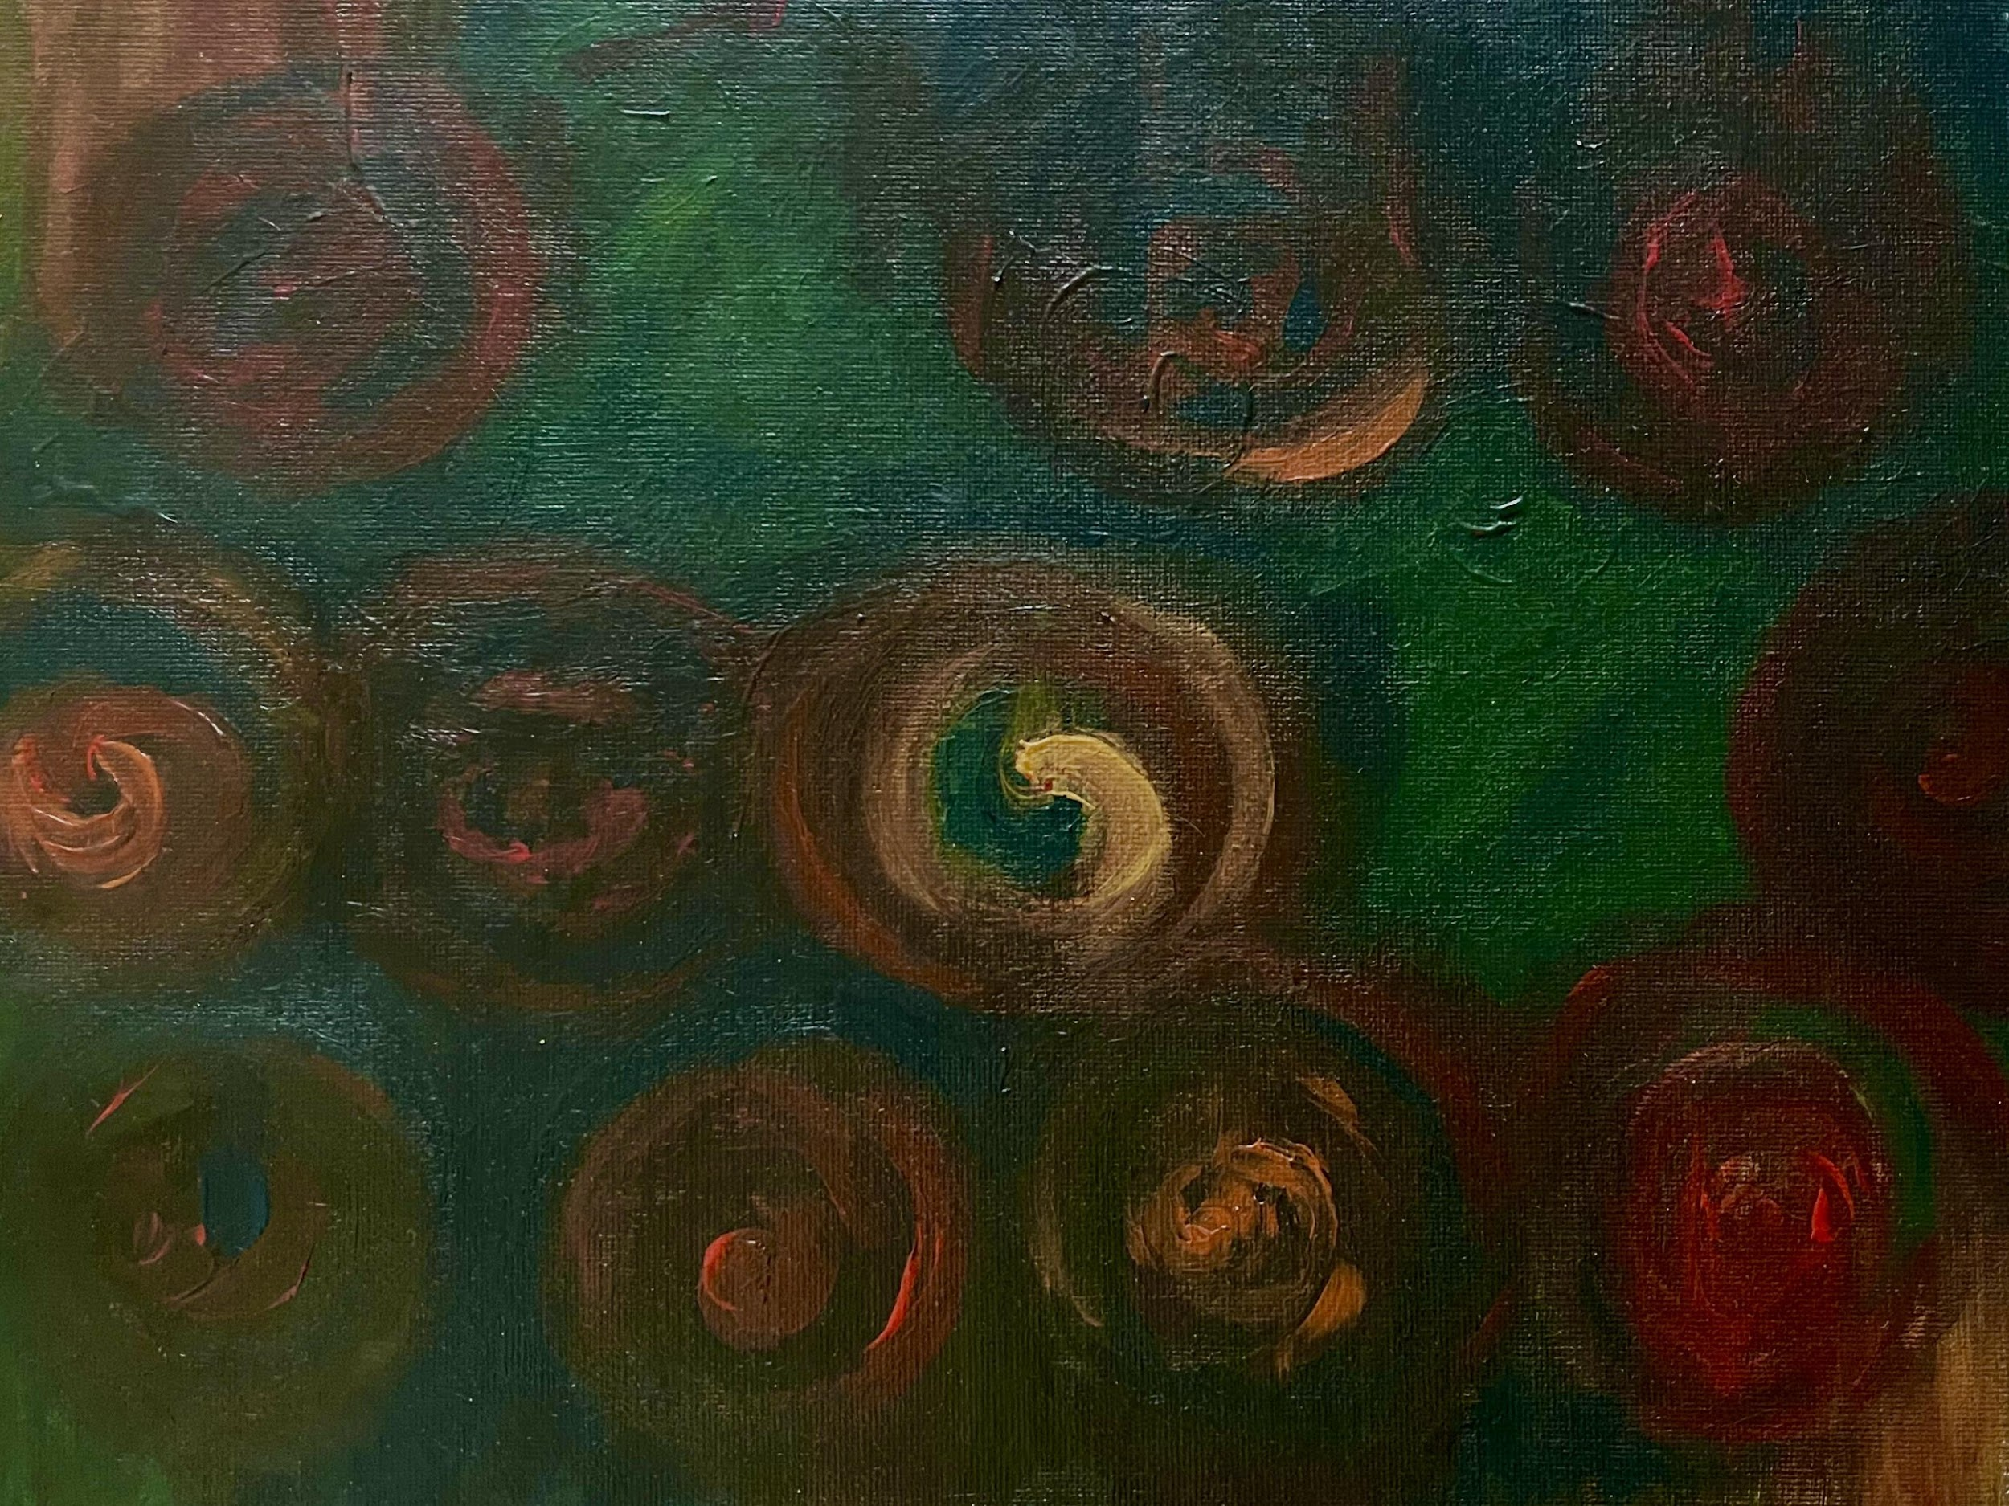
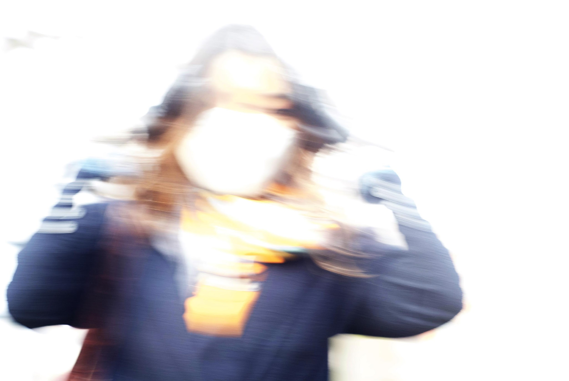
Migraine Headache: “Lucid Dream, Blinding, Throbbing”
"I guess I don't really talk about it much when I do [get a migraine], because I’ll just say I'm taking a nap or something... I don't want to be known as the person with the perpetual headaches or as someone who's perpetually sick."

Slide 5
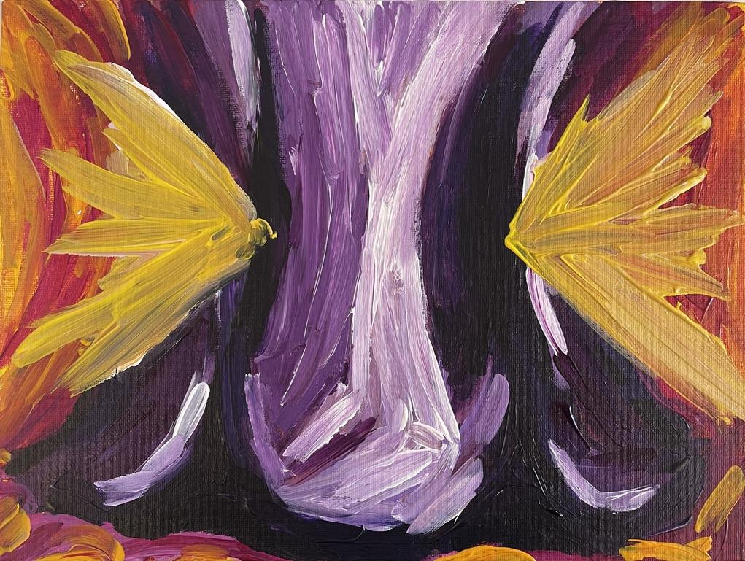
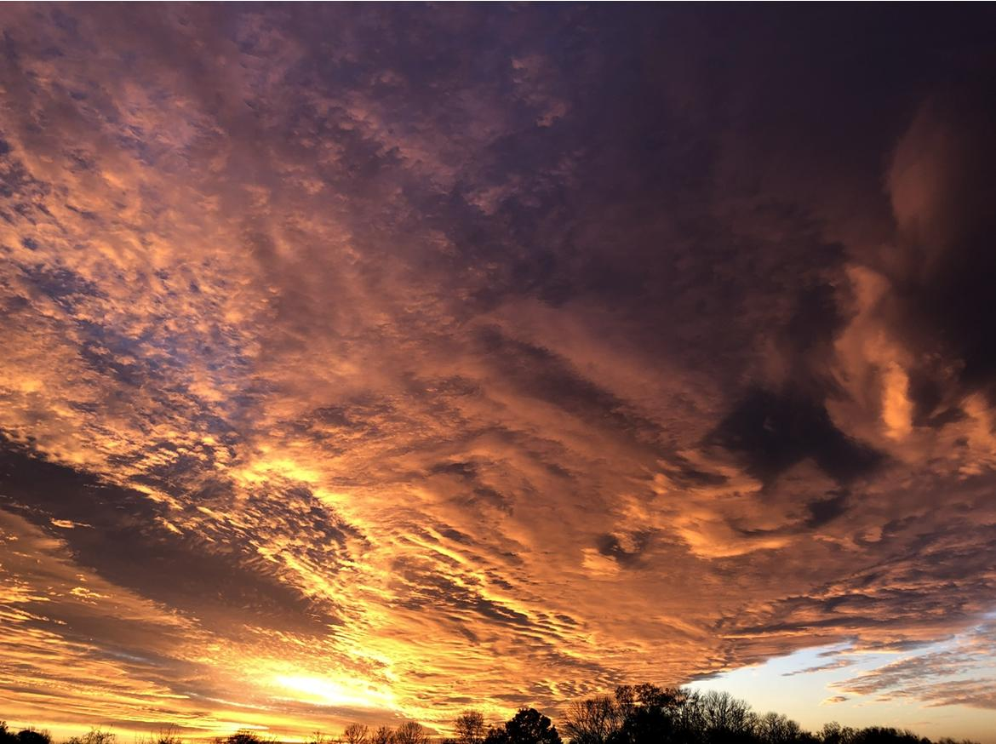
Migraine Headache: “Congestion, Weight, Pressure”
"I felt like a burden sometimes because [when my family] had to take me to neurologist appointments, they had to call into school and the whole schedule was adjusted...it made me feel…guilty."

Slide 6
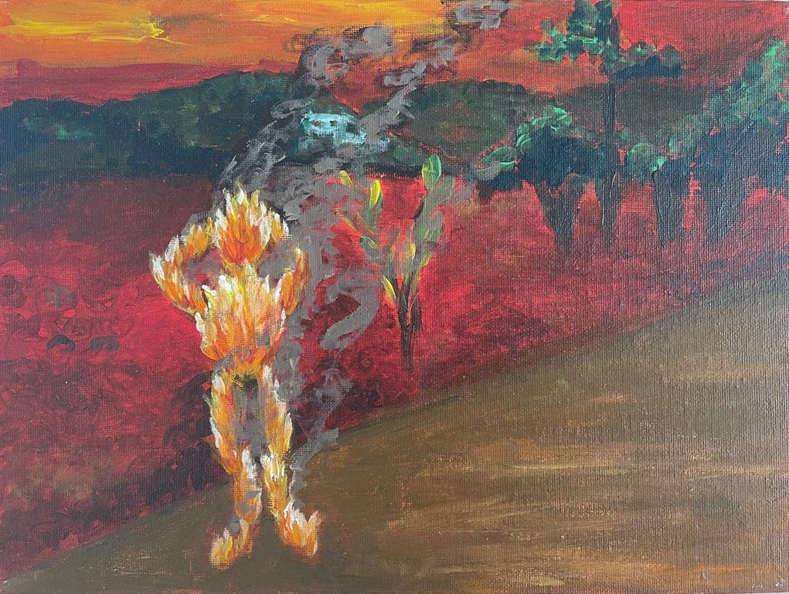
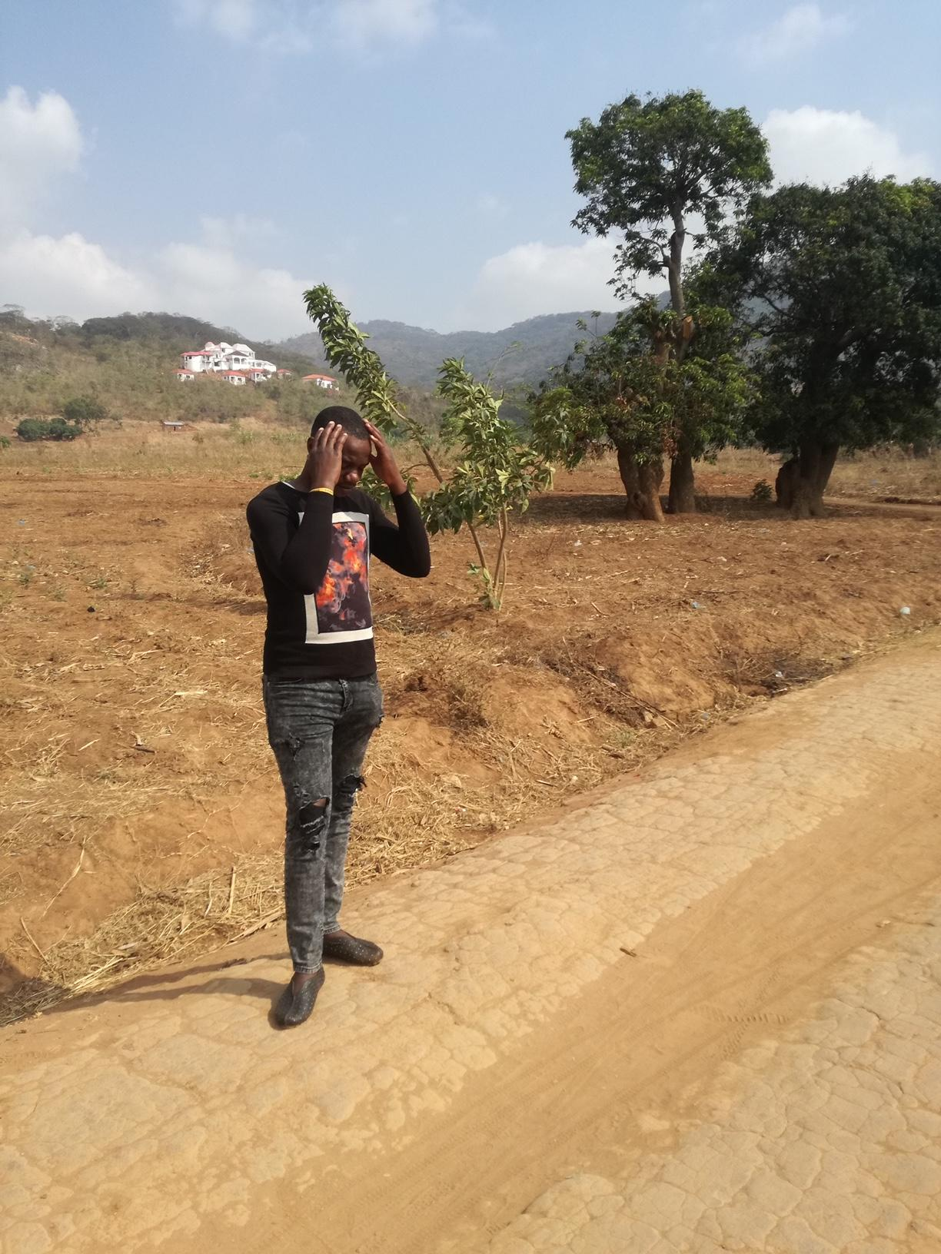
Migraine Headache: “Boiling, Crippling, Stagnated”
"Honestly, this chronic headache has killed the real me. I am not myself, I am no longer a fighter, I feel defeated, and worse still it has affected my normal functioning as a human being."

Slide 7
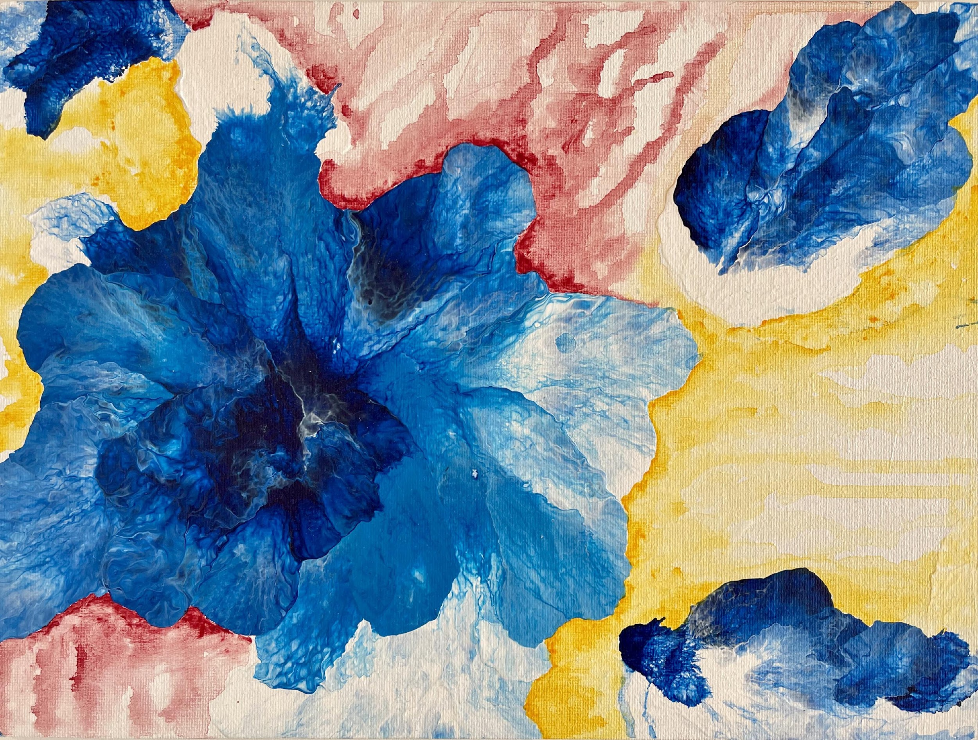
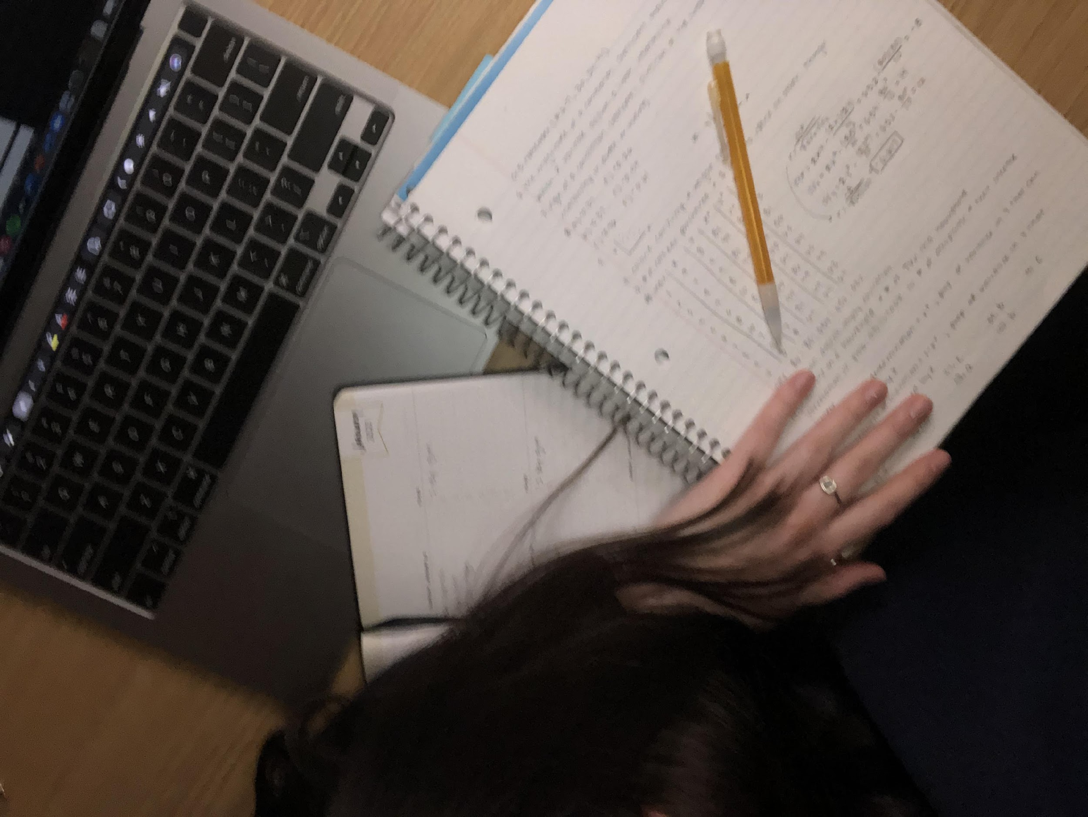
Migraine Headache: “Fuzzy, Flashing, Unknown”
"I feel like [migraines]…help me grow stronger as a person...if I didn't have my headaches, I wouldn't know my limit...or how far I can go...I feel like they've helped me grow stronger emotionally because of what I've had to go through."

Slide 8
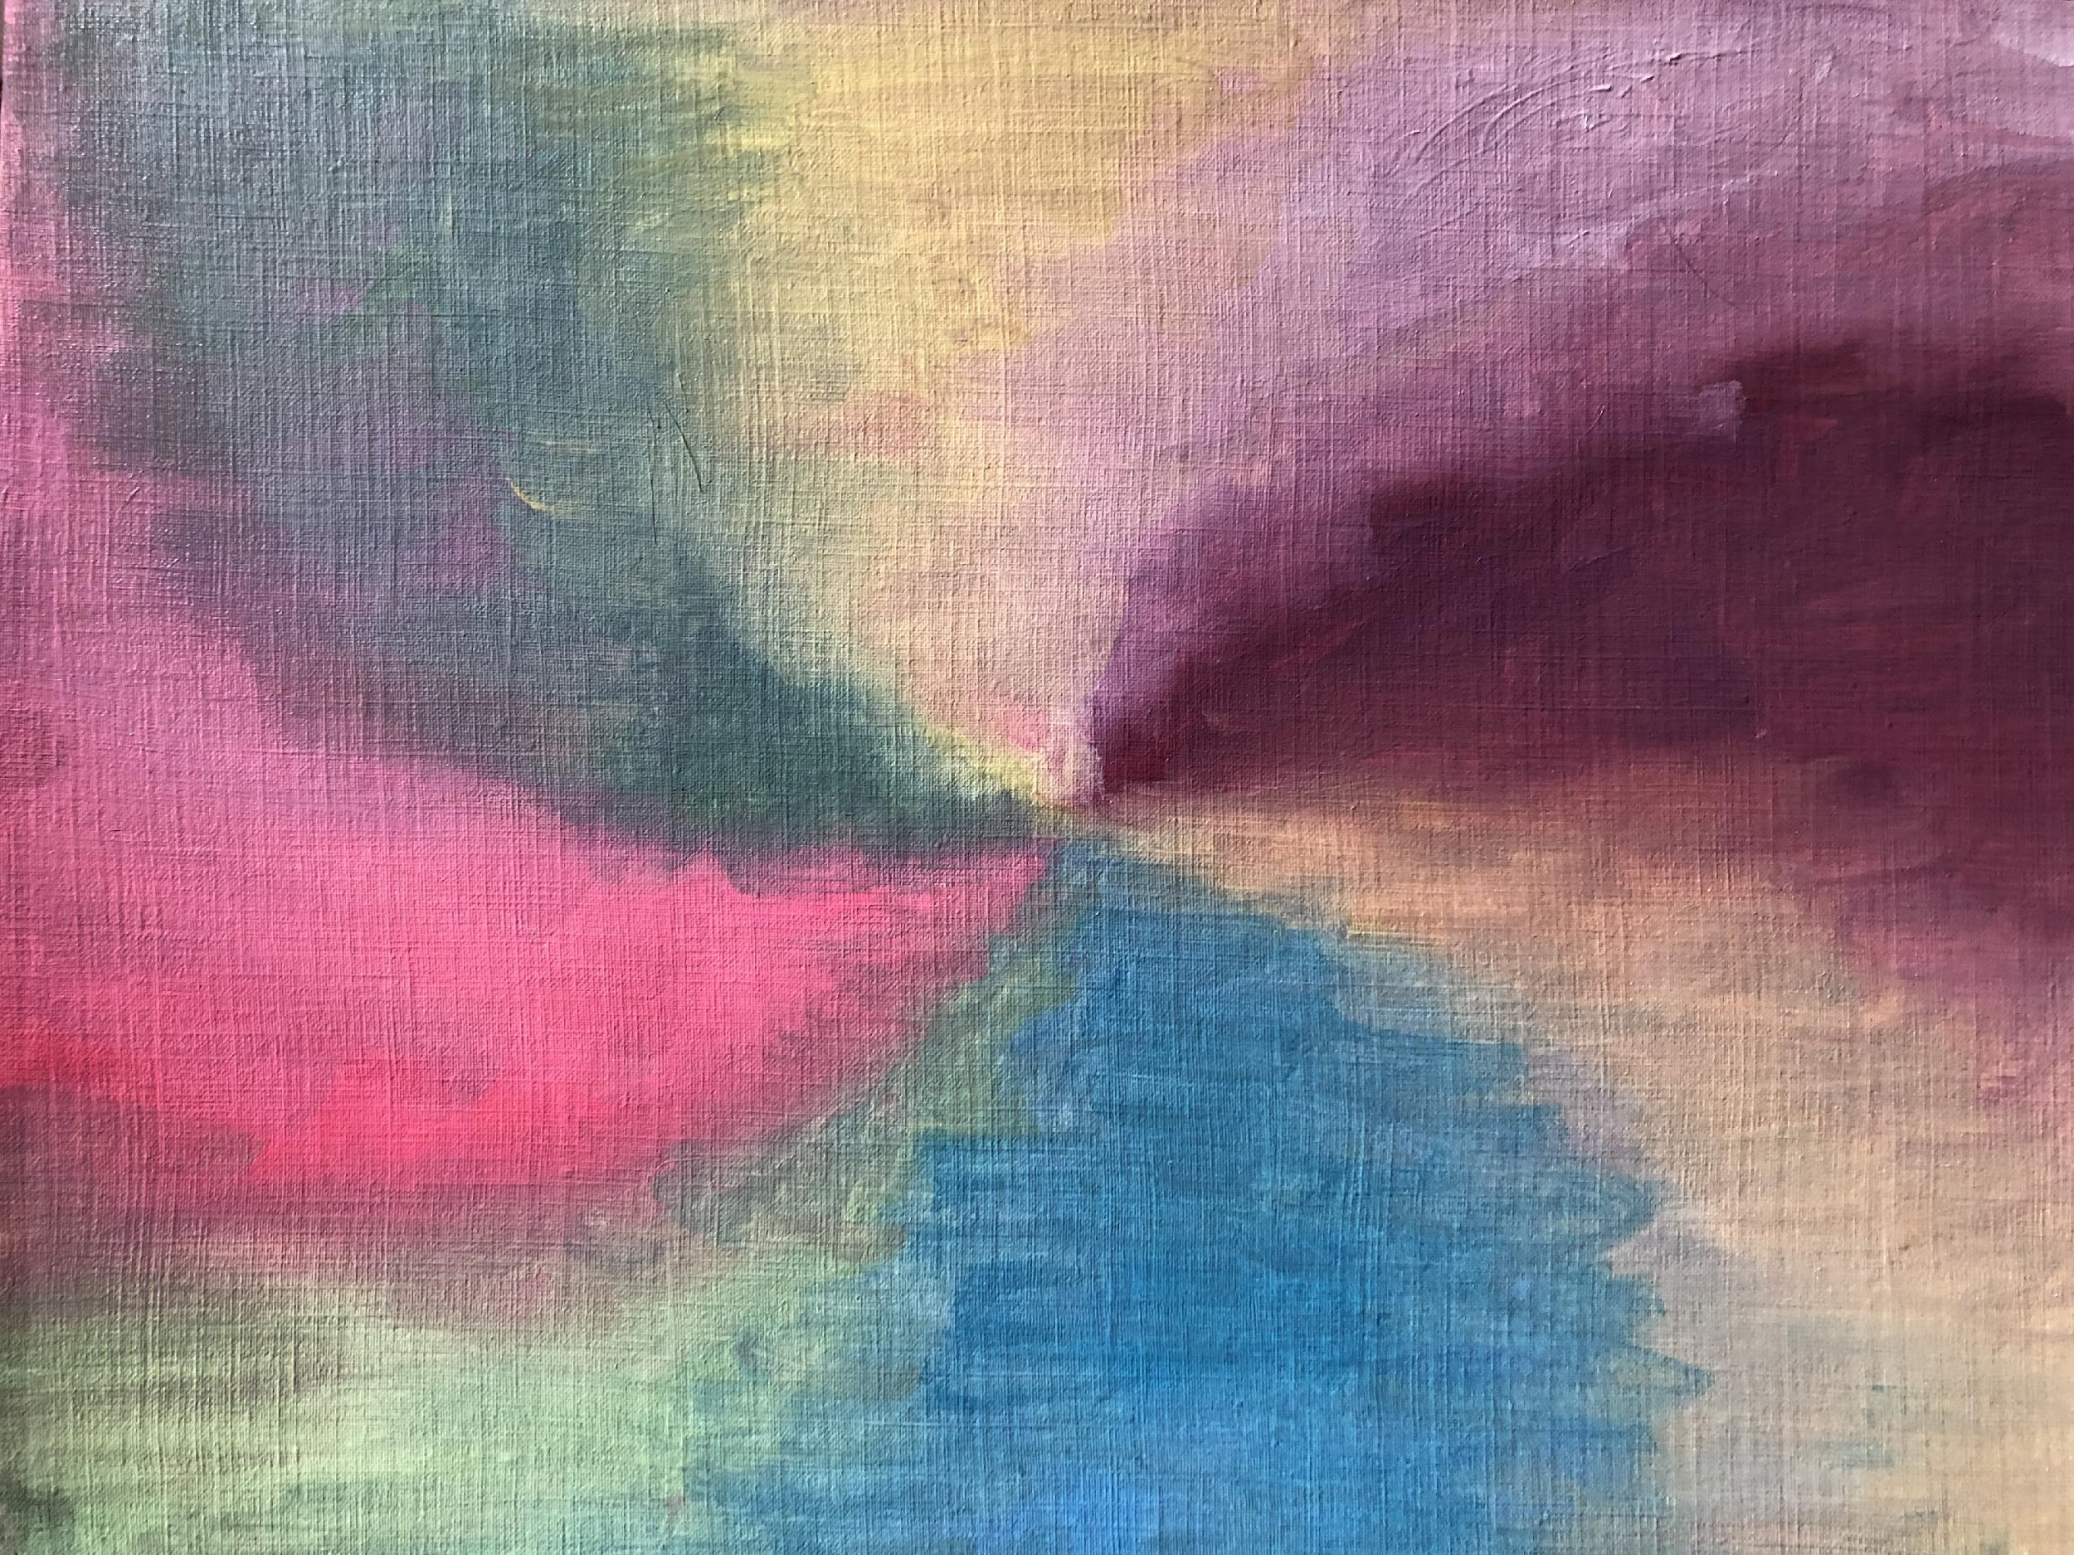
Cluster Headache: “Dazed, funky, meditative”

Slide 9
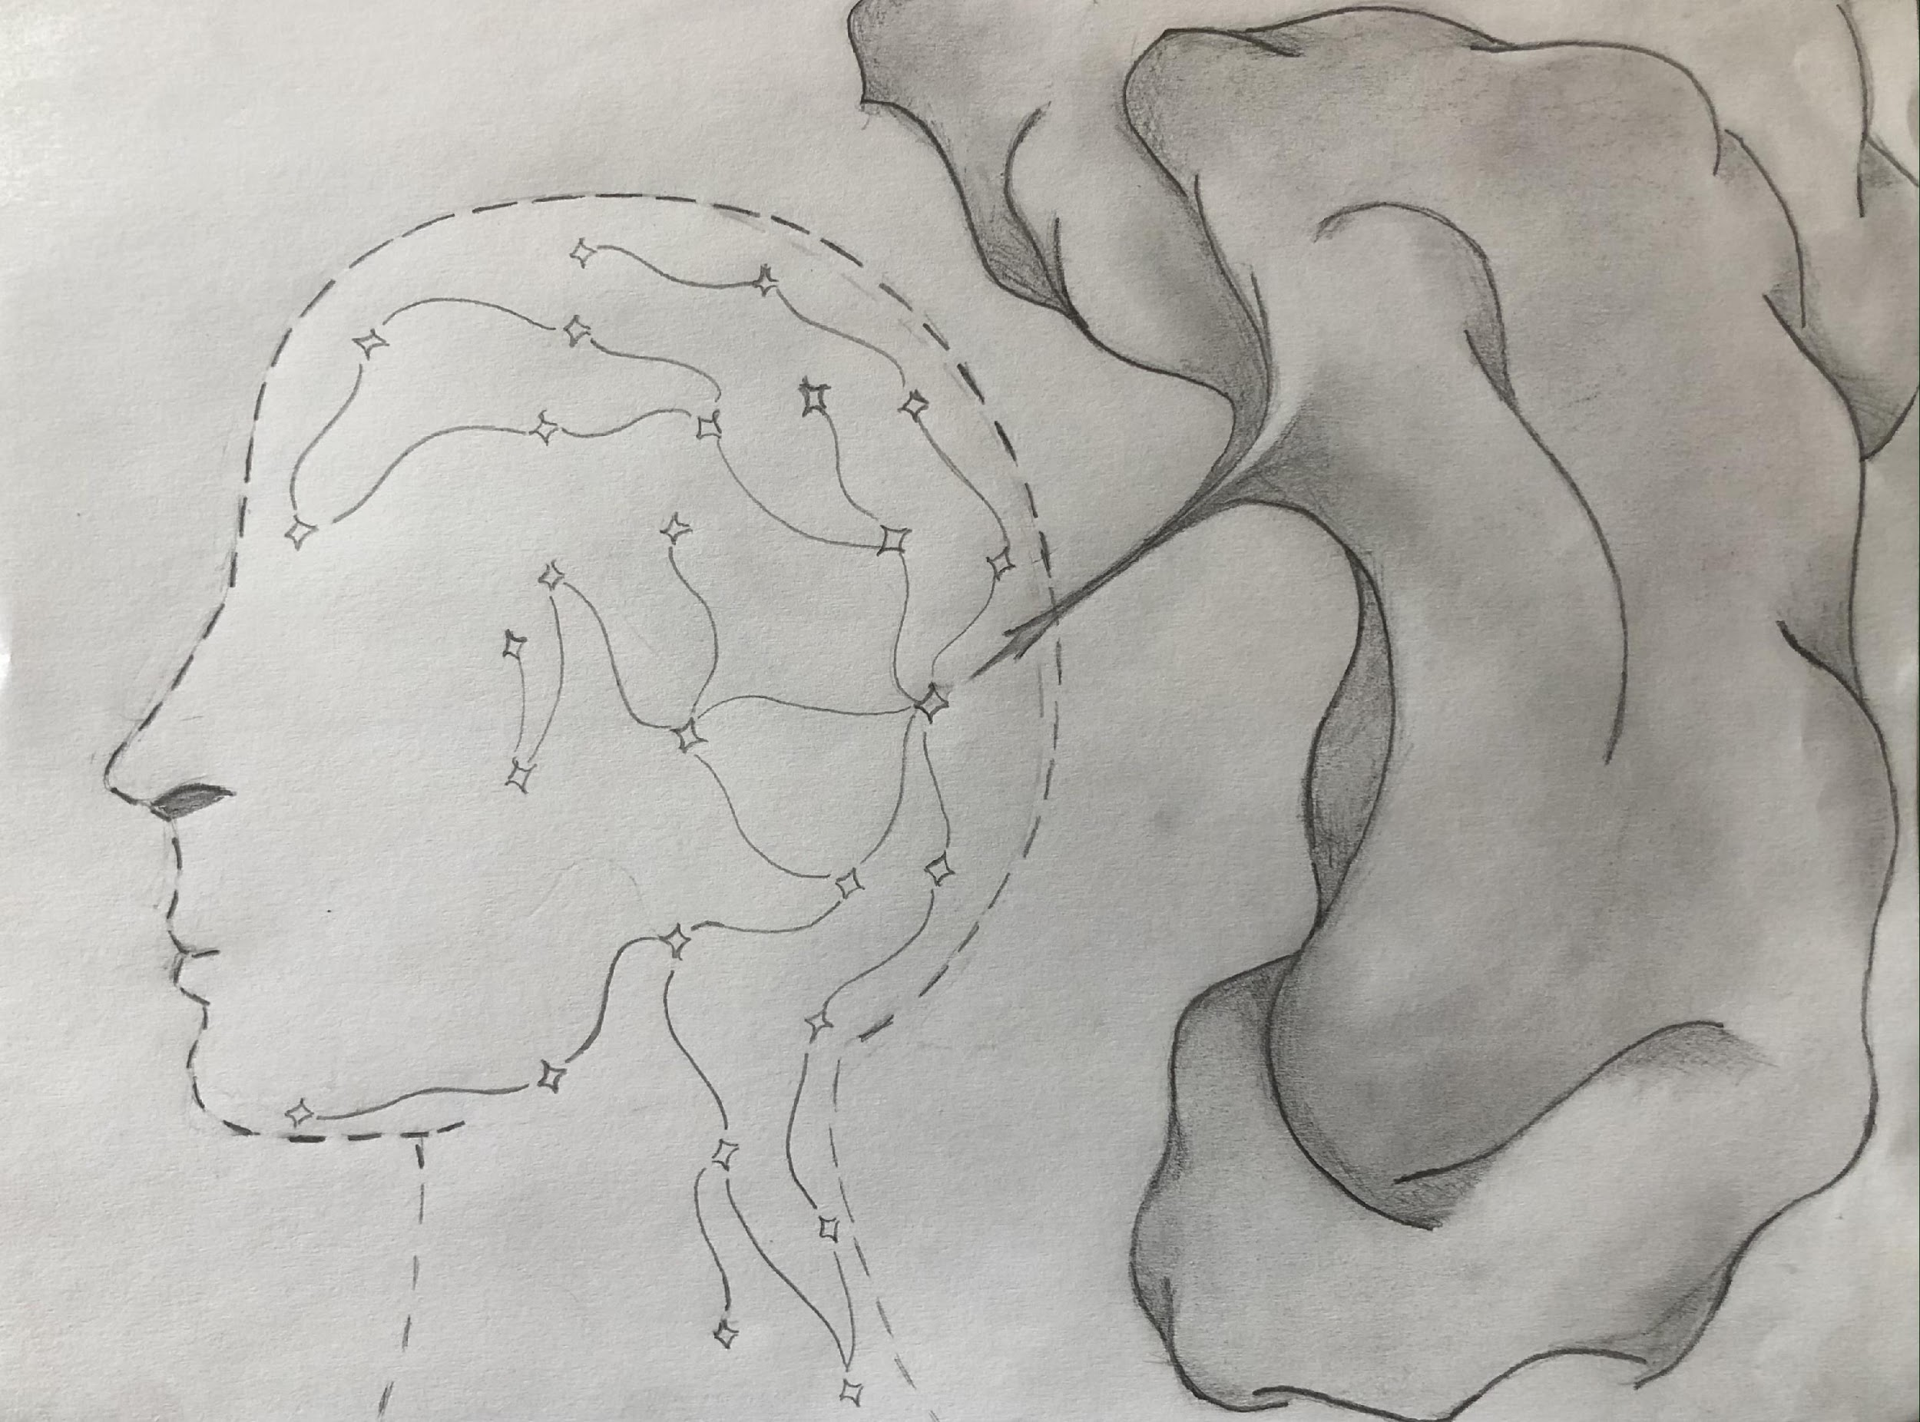
Occipital Headache: “Light, shot, concussive”

Slide 10
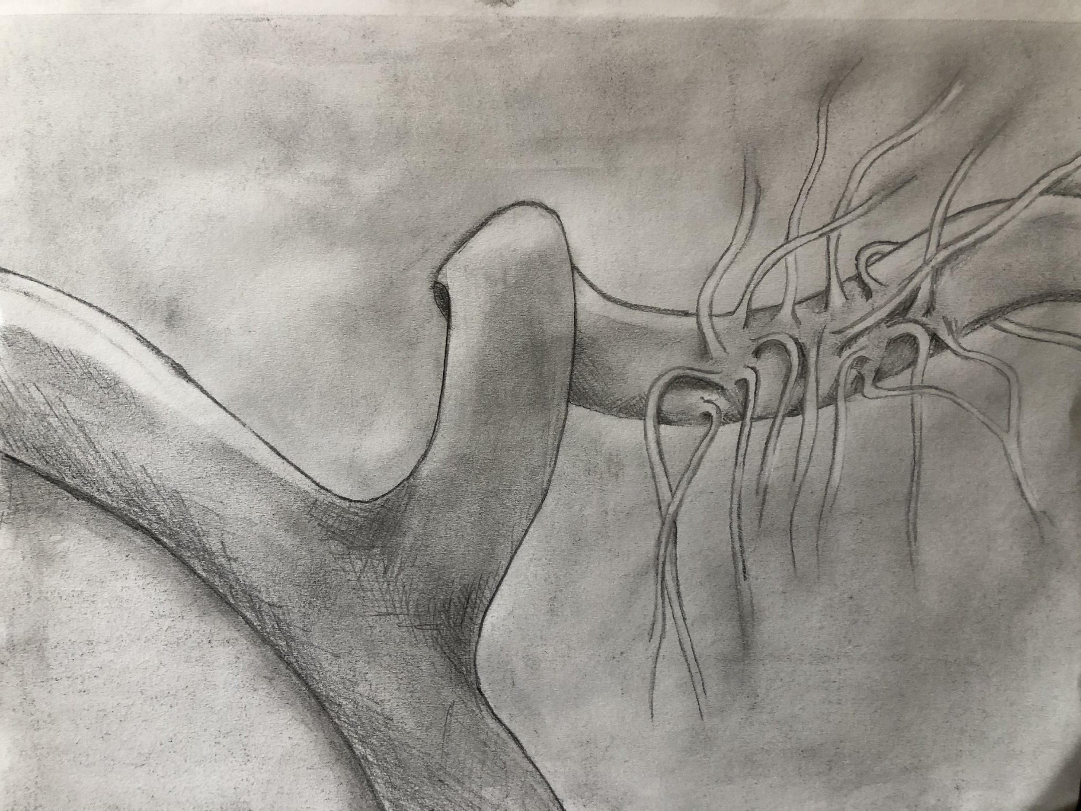
Migraine headache with venous angioma: “Fire, screaming, white noise”

Slide 11
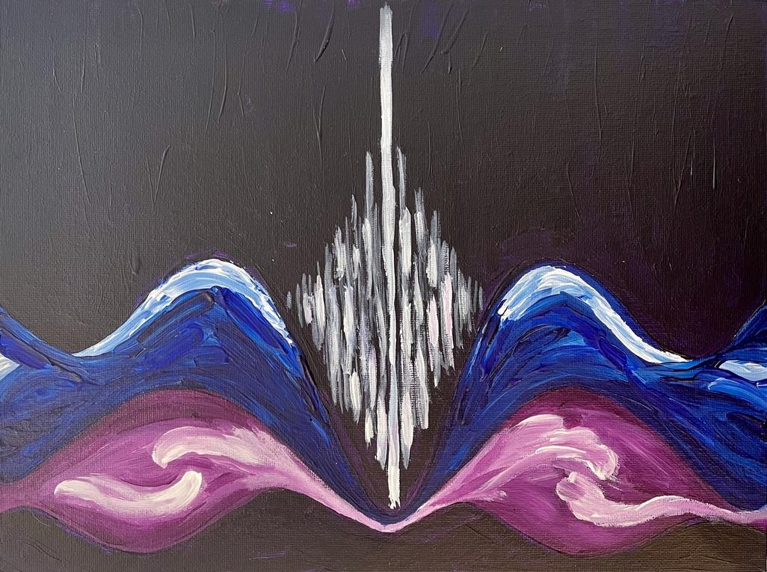
Migraine headache: “throbbing, disruptive, night”

